Slide 1
Big Data – Spark Hands-On 1
Arnaud Nauwynck - Oct 2022

Slide 2
Objectives
1/ Install on your (Windows) PC a minimalist local SPARK
2/ Configure it, launch spark-shell
3/ Discover spark-shell scala> REPL
4/ Execute basic spark commands on DataSets

Slide 3
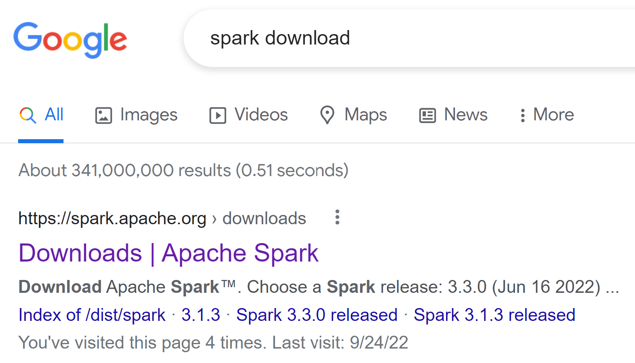
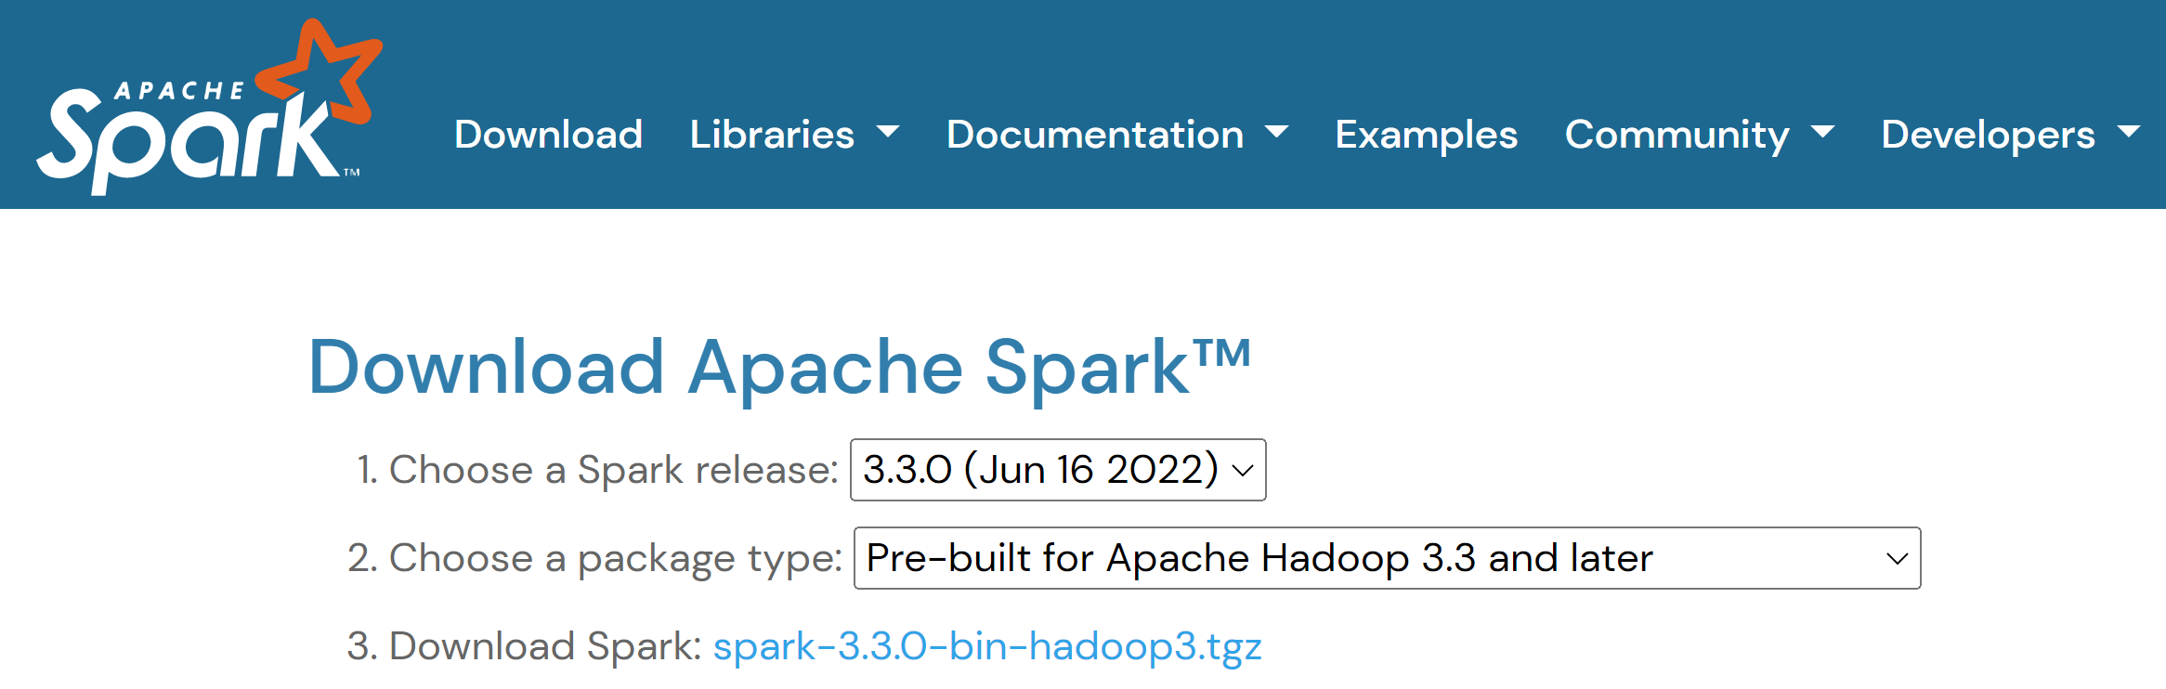
Step 1: Download Spark
https://spark.apache.org/downloads.html
~ 285 Mo

Slide 4
Step 2: Unzip for example in C:\apps\hadoop\spark
From cygwin / Linux ? => simply type « tar zxf spark*.tgz »
From Windows …

Slide 5
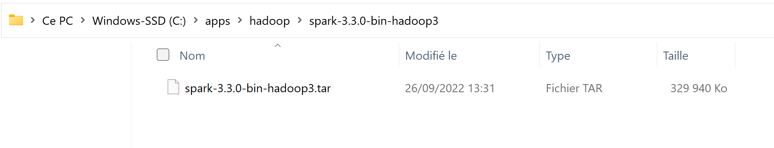
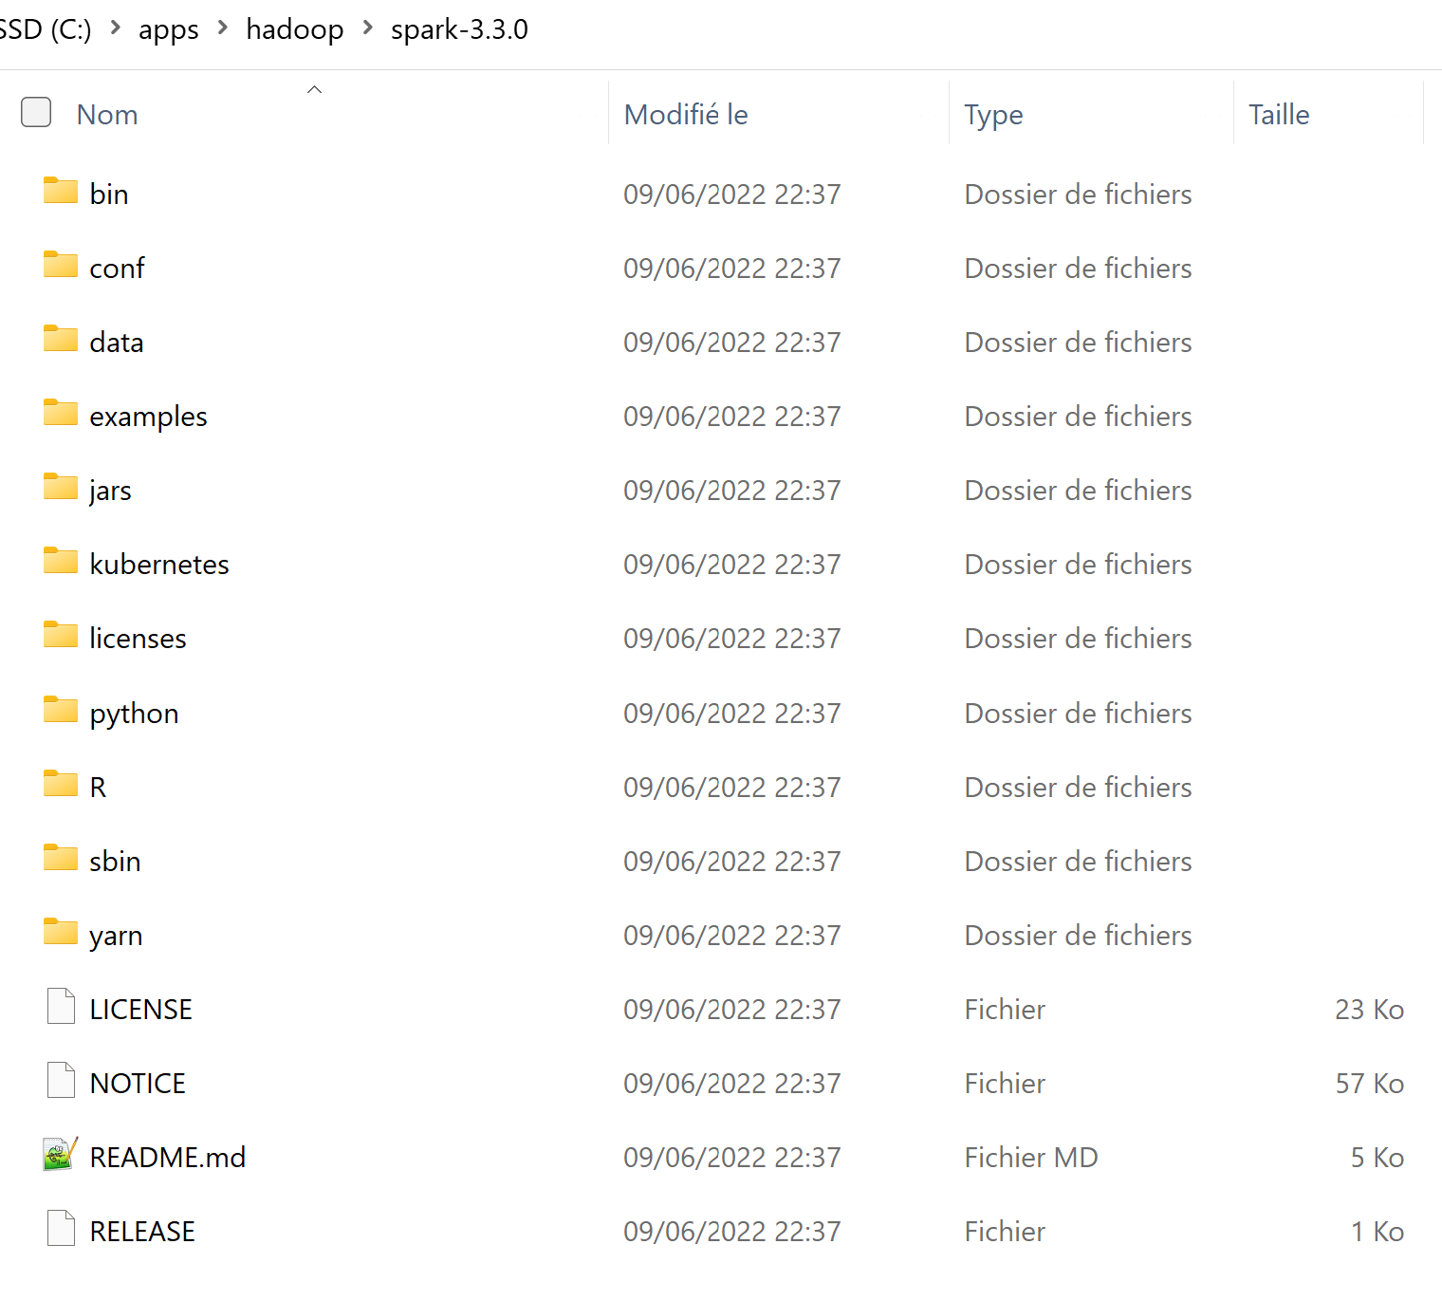
Step 2… check extract « .tar » file!
Simplify… move and rename sub-sub dir
to « c:\apps\hadoop\spark-3.3.0 »

Slide 6
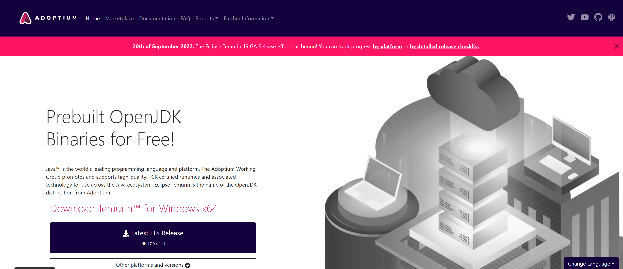
Step 3: Pre-requisite Install JDK 17
Notice: most of Hadoop still use Java 8+linux.. But cmd error on windows?
JDK is Open-Source, but pre-built binaries may be licenced if downloading from oracle.com
Download from « adoptium » (previously « adoptOpenJdk »)
https://adoptium.net/

Slide 7
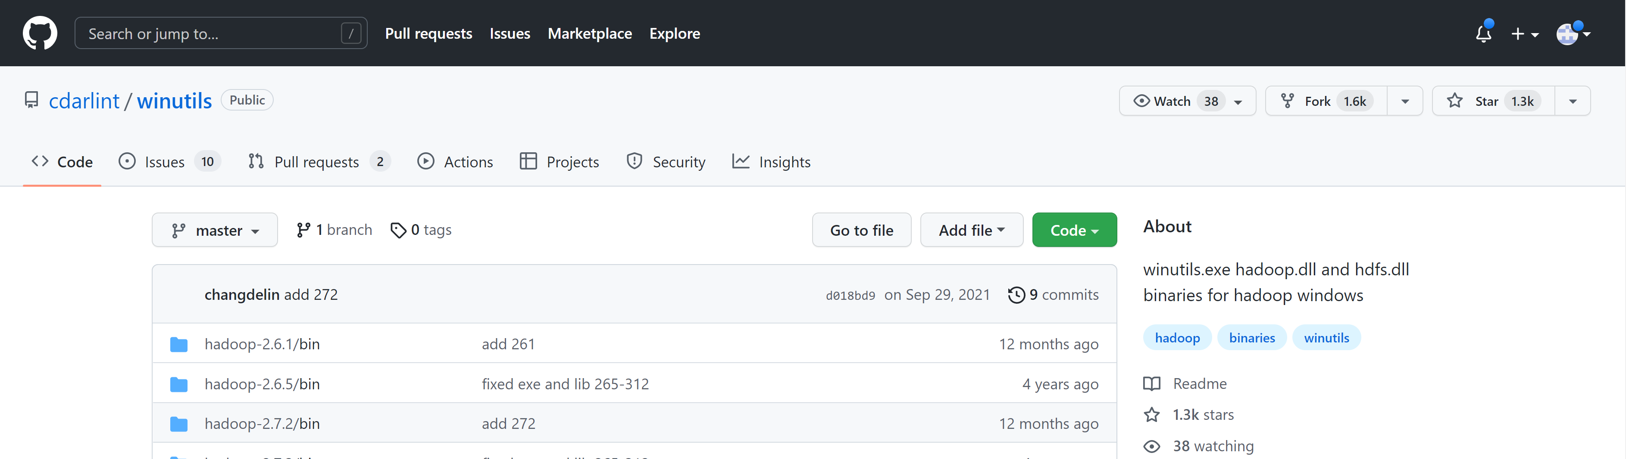
Step 4: on Windows only Download « WinUtils »
https://github.com/cdarlint/winutils

Slide 8
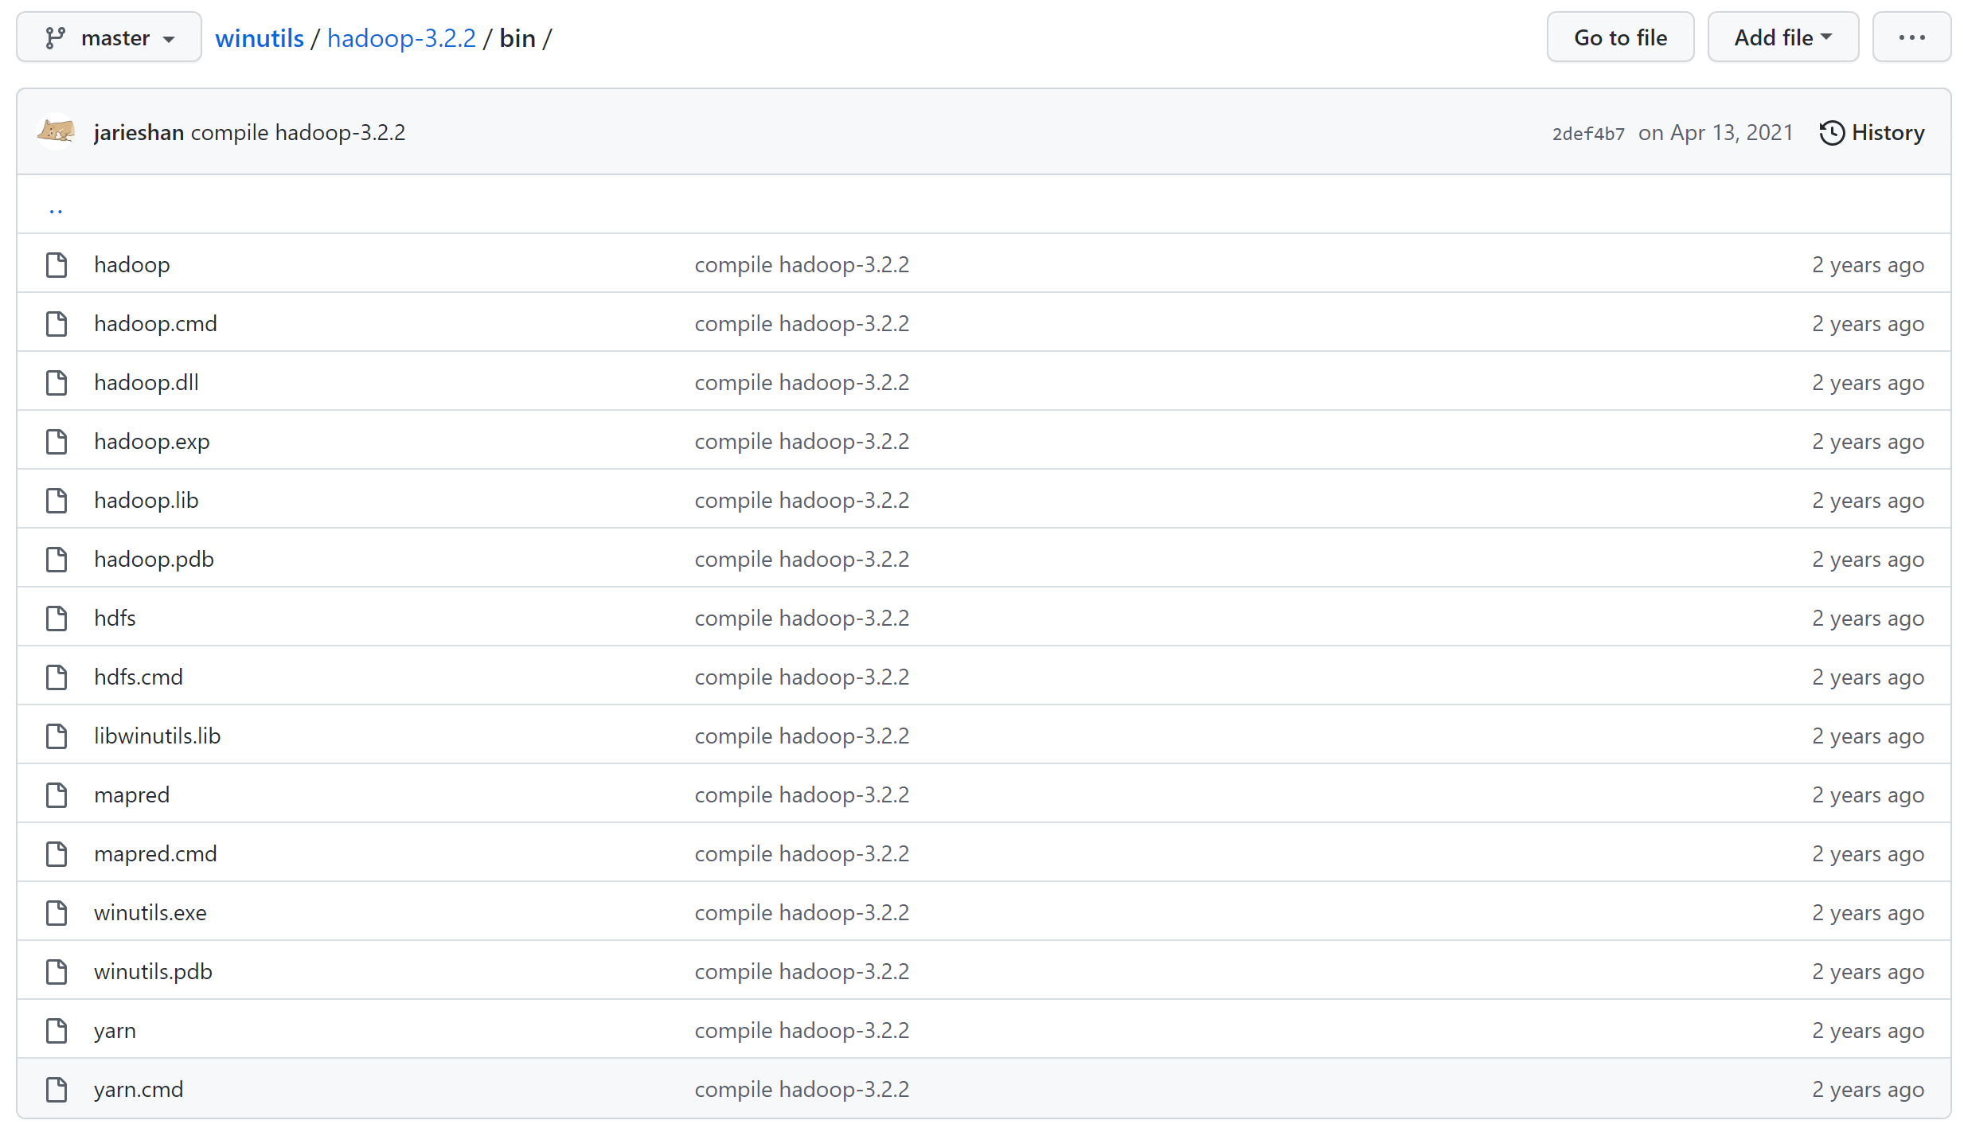
Step 4… Copy winutils.exe, hadoop.dll to you Spark (or Hadoop) \bin\

Slide 9
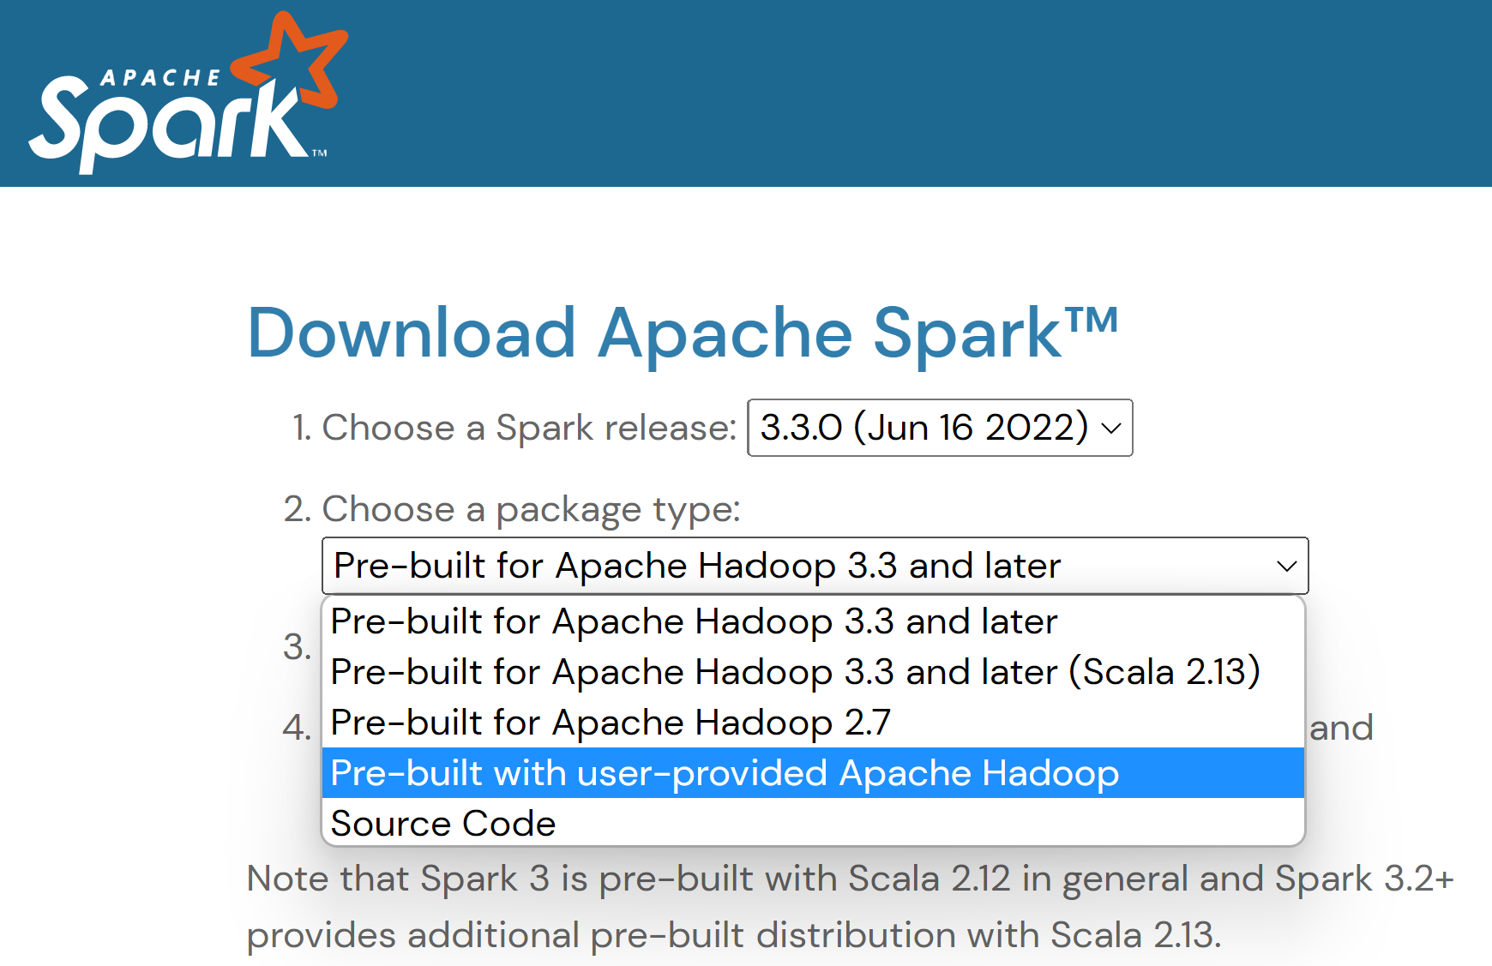
Step 5/ … optionnal for this TD1, but needed for after
Re-download spark, packaging = « with user-provided Apache Hadoop »

Slide 10
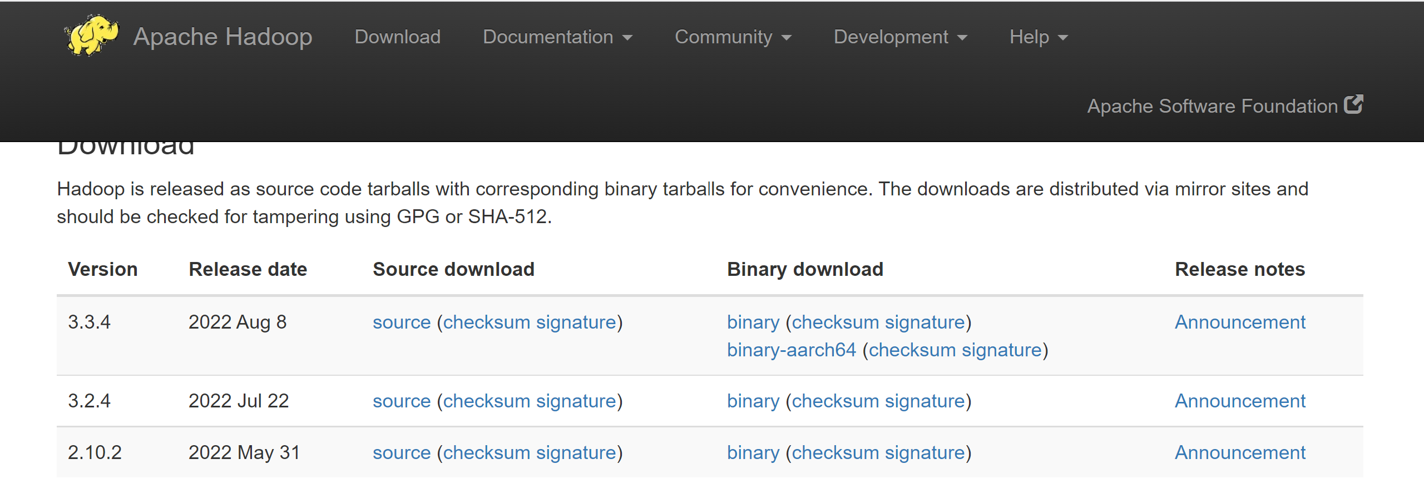
Step 5/ Download user-defined Hadoop
https://hadoop.apache.org/releases.html

Slide 11
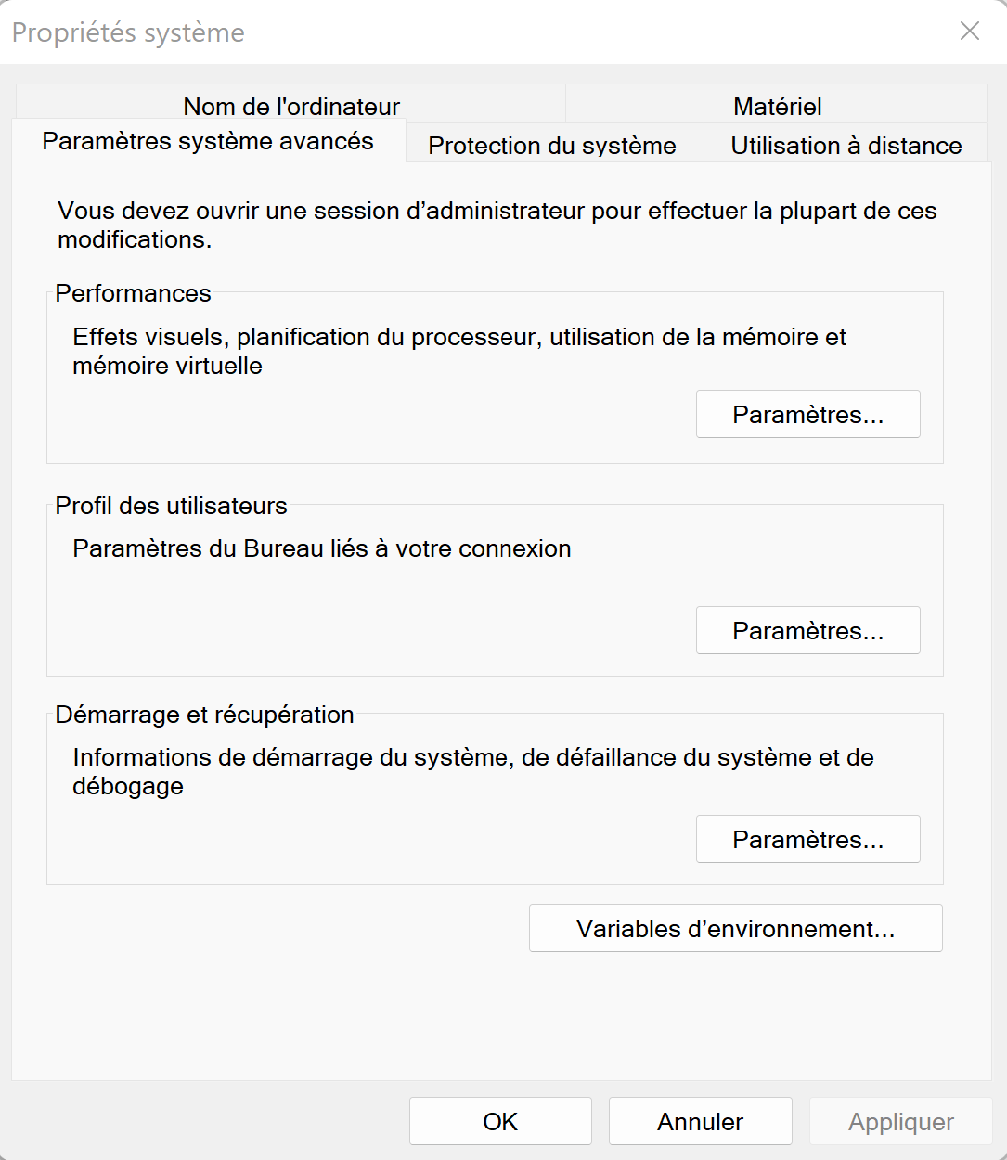
Step 6 : Configure Environment Variables
Prefer edit + executing specific « c:\apps\setenv-xyz-version-123.bat »
Rather then Edit Windows System

Slide 12
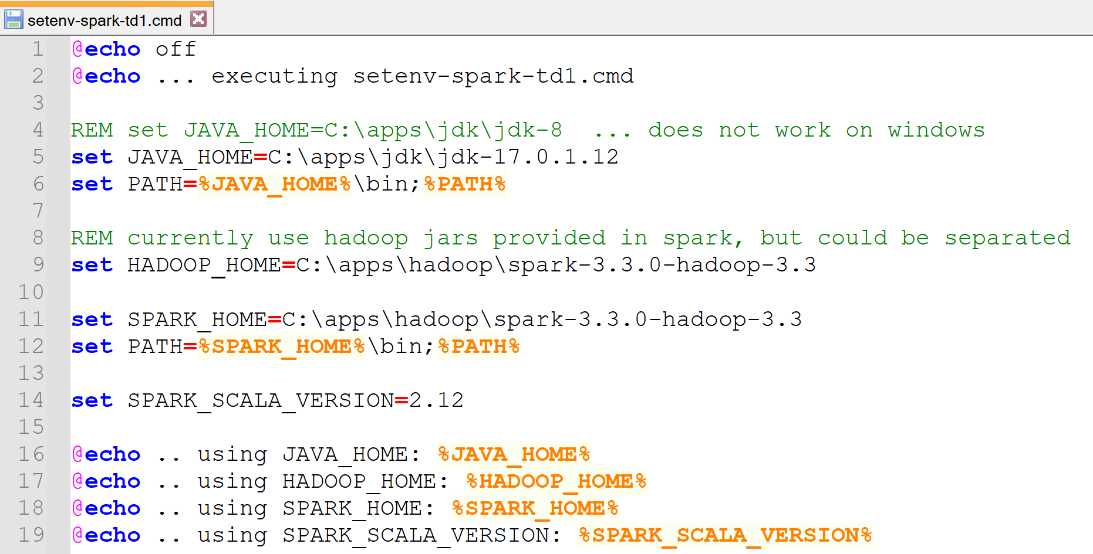
Step 6: set JAVA_HOME , PATH, SPARK_HOME, SPARK_SCALA_VERSION HADOOP_HOME

Slide 13
Step 6… If using explicit user-defined Hadoop … need spark-env.{sh|cmd} SPARK_DIST_CLASSPATH=$( hadoop classpath )

Slide 14
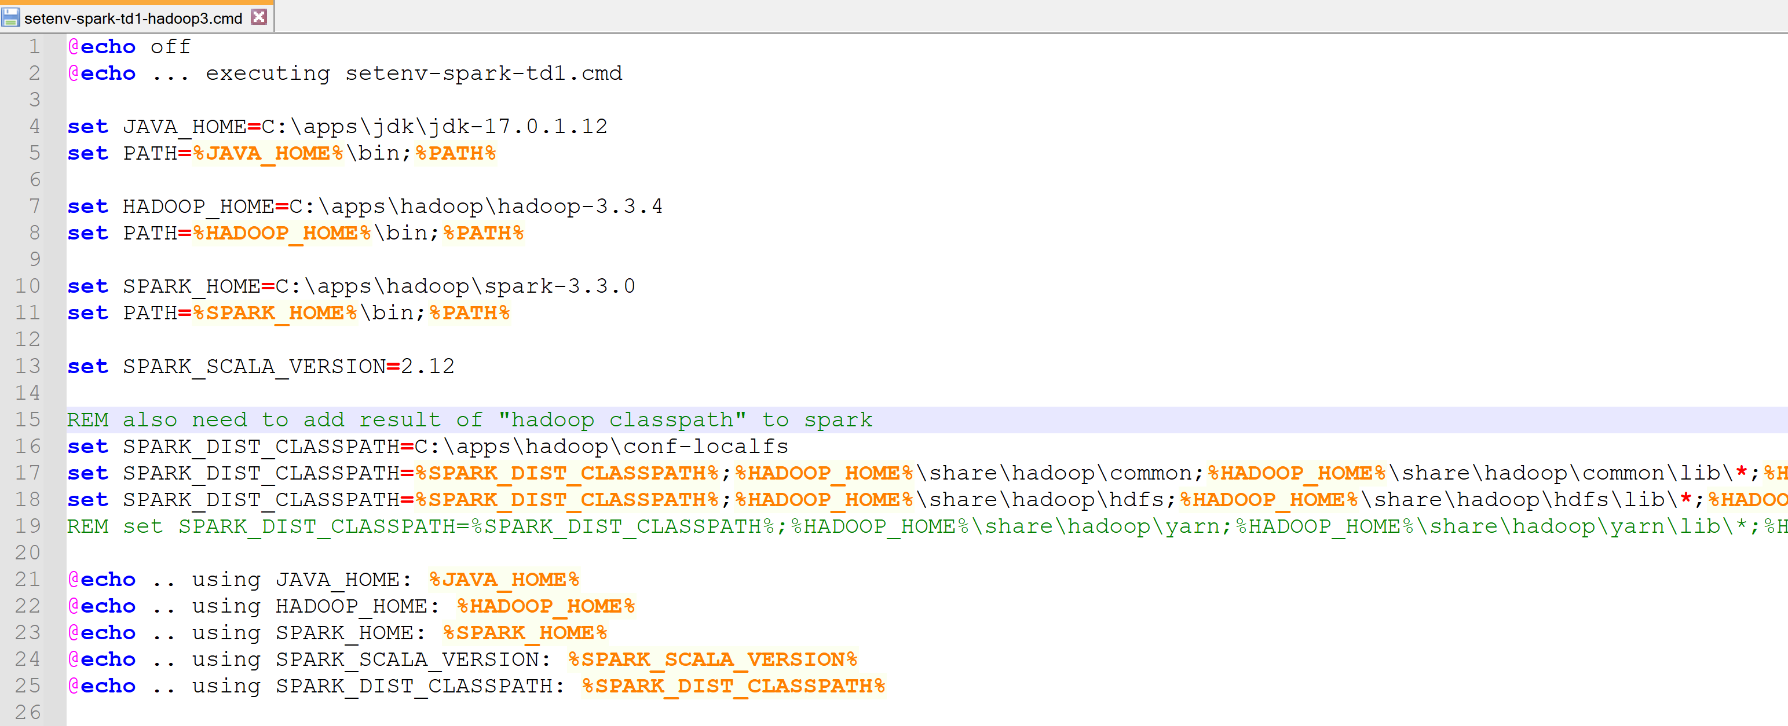
if using explicit HADOOP_HOME (recommended for fine-grained configuration / versions)

Slide 15
Step 6 … Error if forgetting SPARK_DIST_CLASSPATH
NO Detailed!!! … Internally spark-shell expand to command =>
C:\apps\jdk\jdk-17.0.1.12\bin\java
-cp "C:\apps\hadoop\spark-3.3.0\bin\..\conf\;C:\apps\hadoop\spark-3.3.0\jars\*;C:\apps\hadoop\conf-localfs"
"-Dscala.usejavacp=true" -Xmx1g -XX:+IgnoreUnrecognizedVMOptions
"--add-opens=java.base/java.lang=ALL-UNNAMED" "--add-opens=java.base/java.lang.invoke=ALL-UNNAMED" "--add-opens=java.base/java.lang.reflect=ALL-UNNAMED" "--add-opens=java.base/java.io=ALL-UNNAMED" "--add-opens=java.base/java.net=ALL-UNNAMED" "--add-opens=java.base/java.nio=ALL-UNNAMED" "--add-opens=java.base/java.util=ALL-UNNAMED" "--add-opens=java.base/java.util.concurrent=ALL-UNNAMED" "--add-opens=java.base/java.util.concurrent.atomic=ALL-UNNAMED" "--add-opens=java.base/sun.nio.ch=ALL-UNNAMED" "--add-opens=java.base/sun.nio.cs=ALL-UNNAMED" "--add-opens=java.base/sun.security.action=ALL-UNNAMED" "--add-opens=java.base/sun.util.calendar=ALL-UNNAMED" "--add-opens=java.security.jgss/sun.security.krb5=ALL-UNNAMED"
org.apache.spark.deploy.SparkSubmit
--class org.apache.spark.repl.Main --name "Spark shell" spark-shell

Slide 16
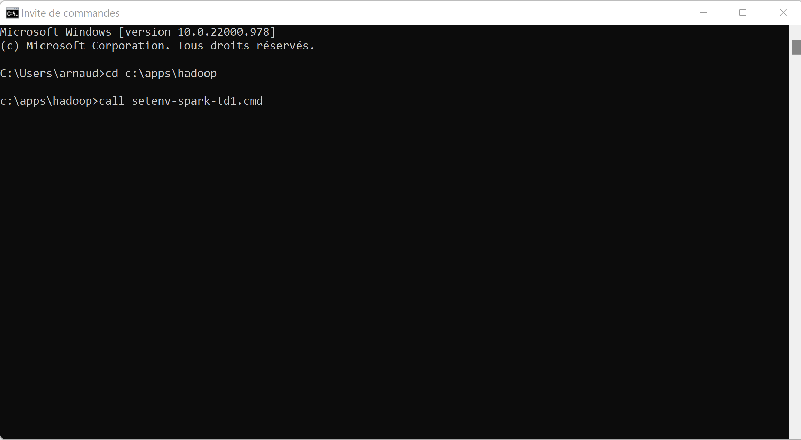
Step 6: Sanity Checks …
Windows > cmd cd <yourdir>
call <your-setenv>.cmd

Slide 17
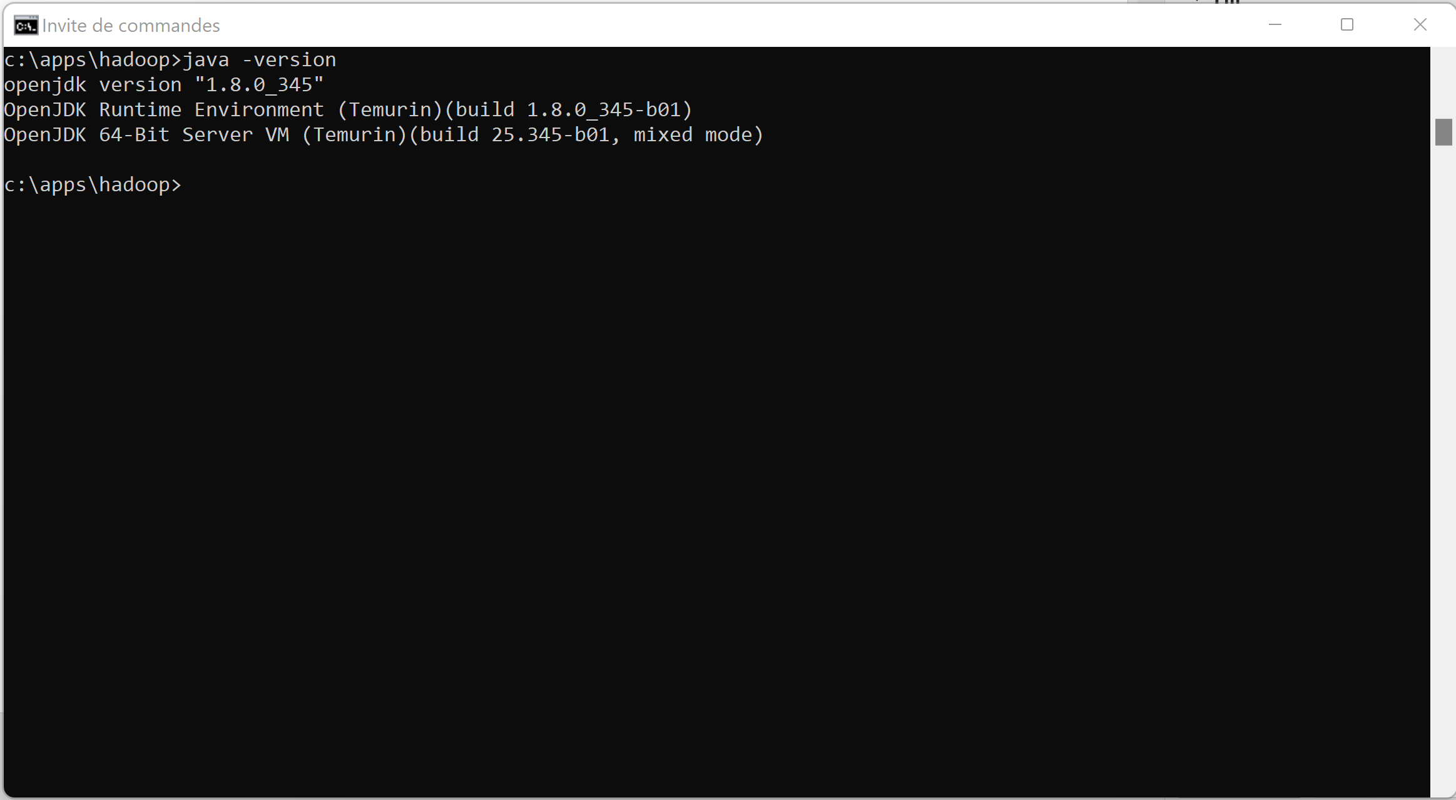
Sanity Check: Java

Slide 18
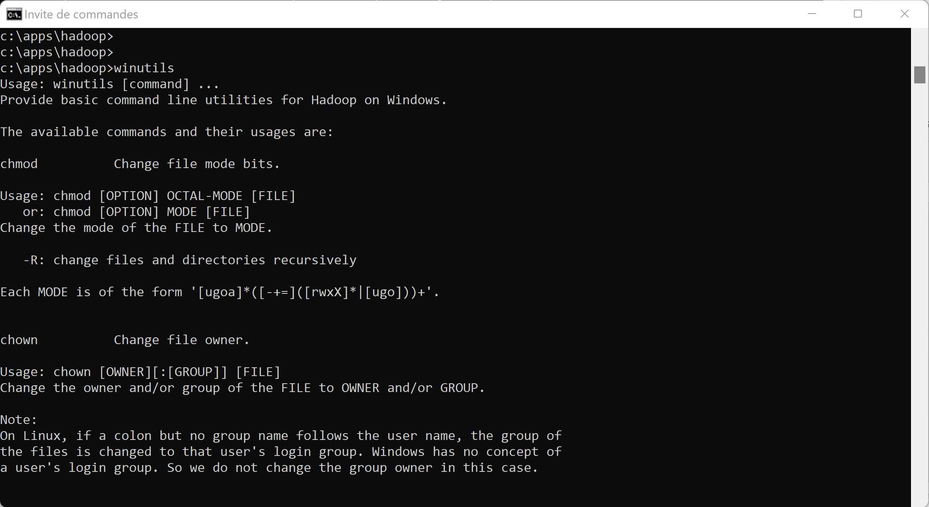
Sanity check: WinUtils

Slide 19
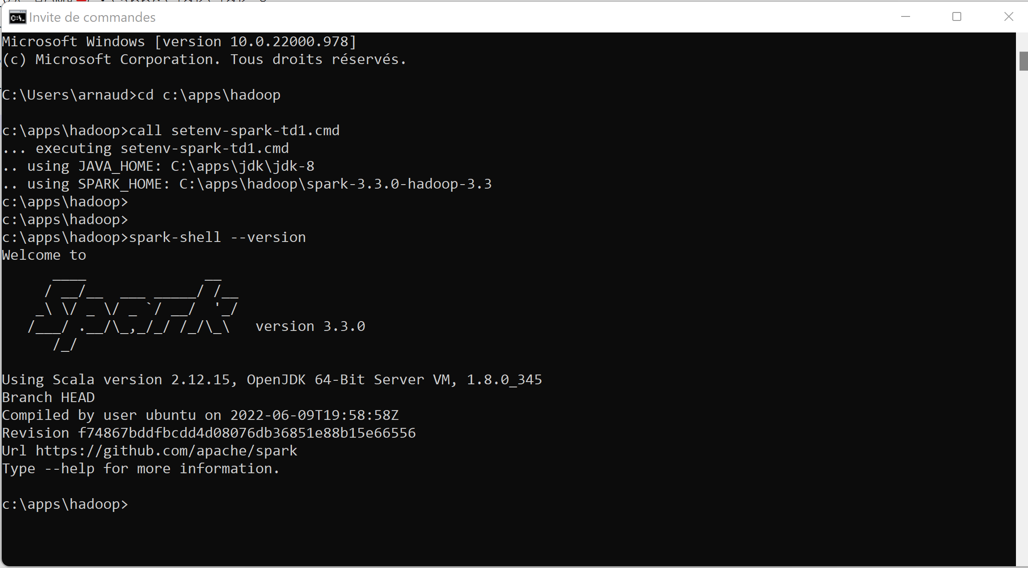
Sanity Check « spark-shell --version »

Slide 20
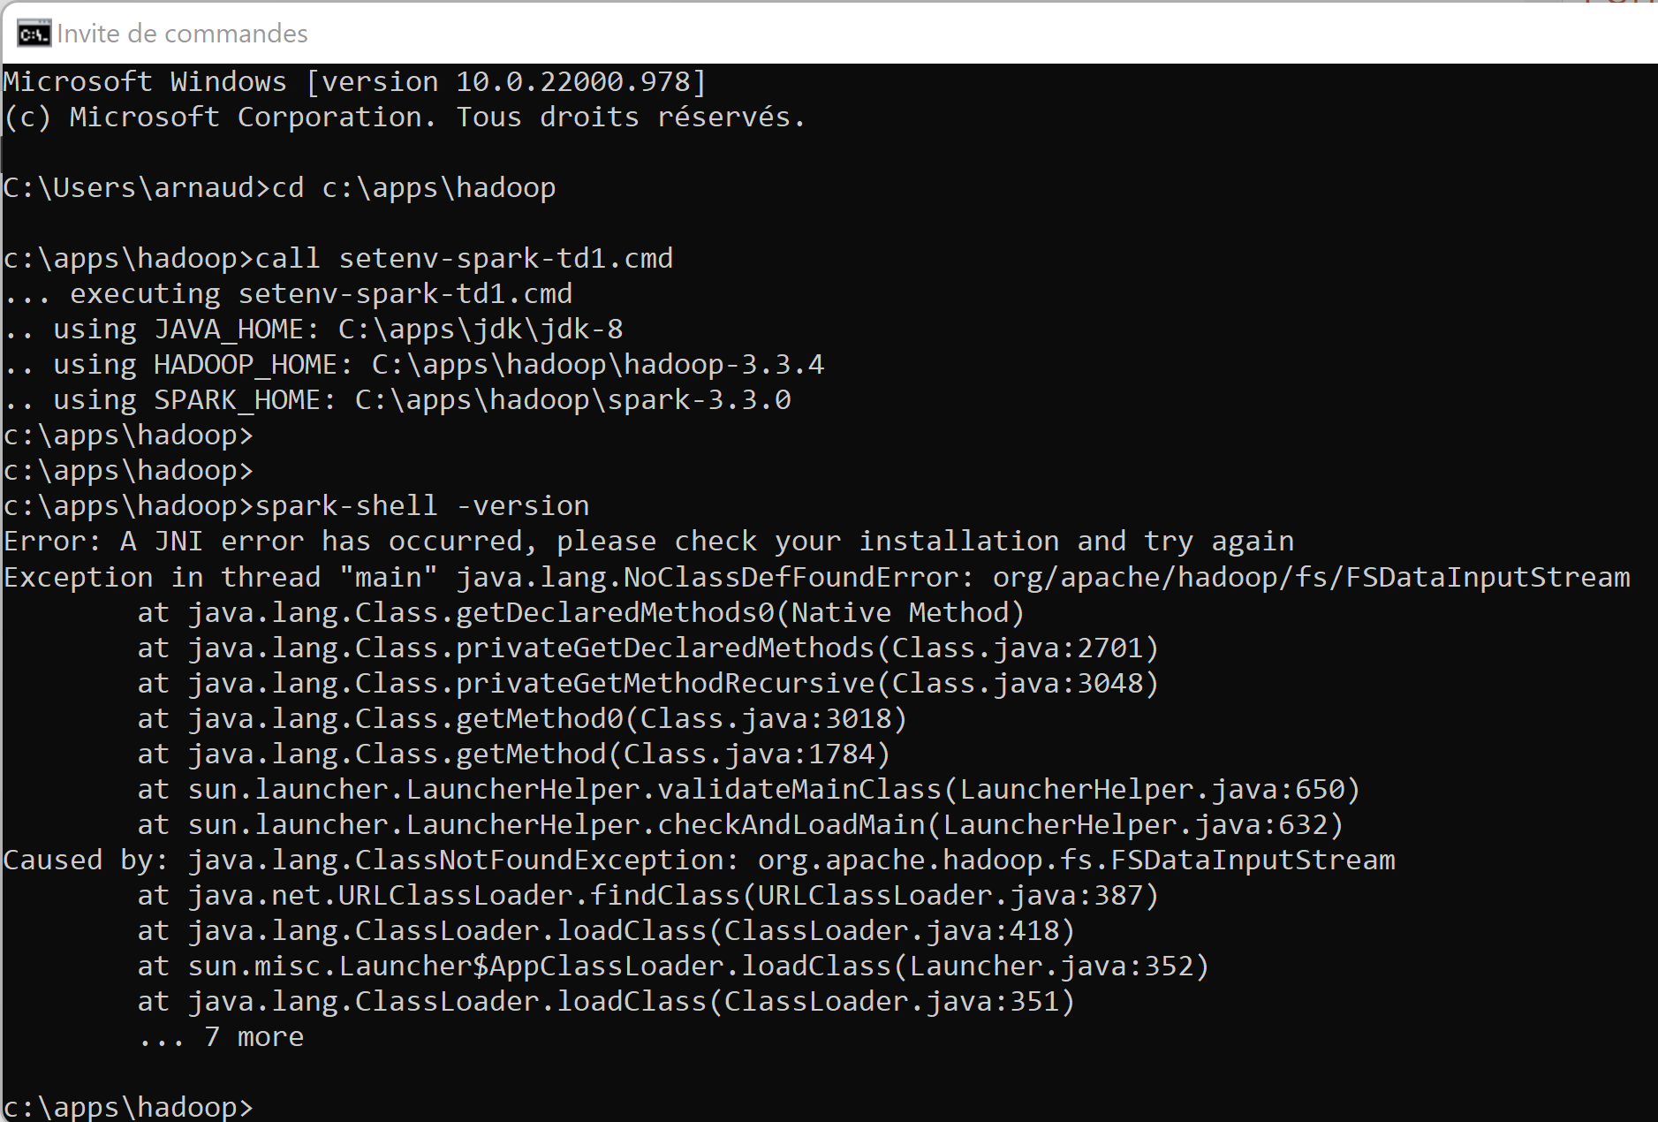
Spark and custom user-defined Hadoop? .. More difficult error when using JDK8 … but ok when JDK17 ?!
Naively think
missing hadoop jars
in spark classpath ?!
… NOT Only !!
Root cause
was jdk version +
Missing env var
SPARK_SCALA_VERSION

Slide 21
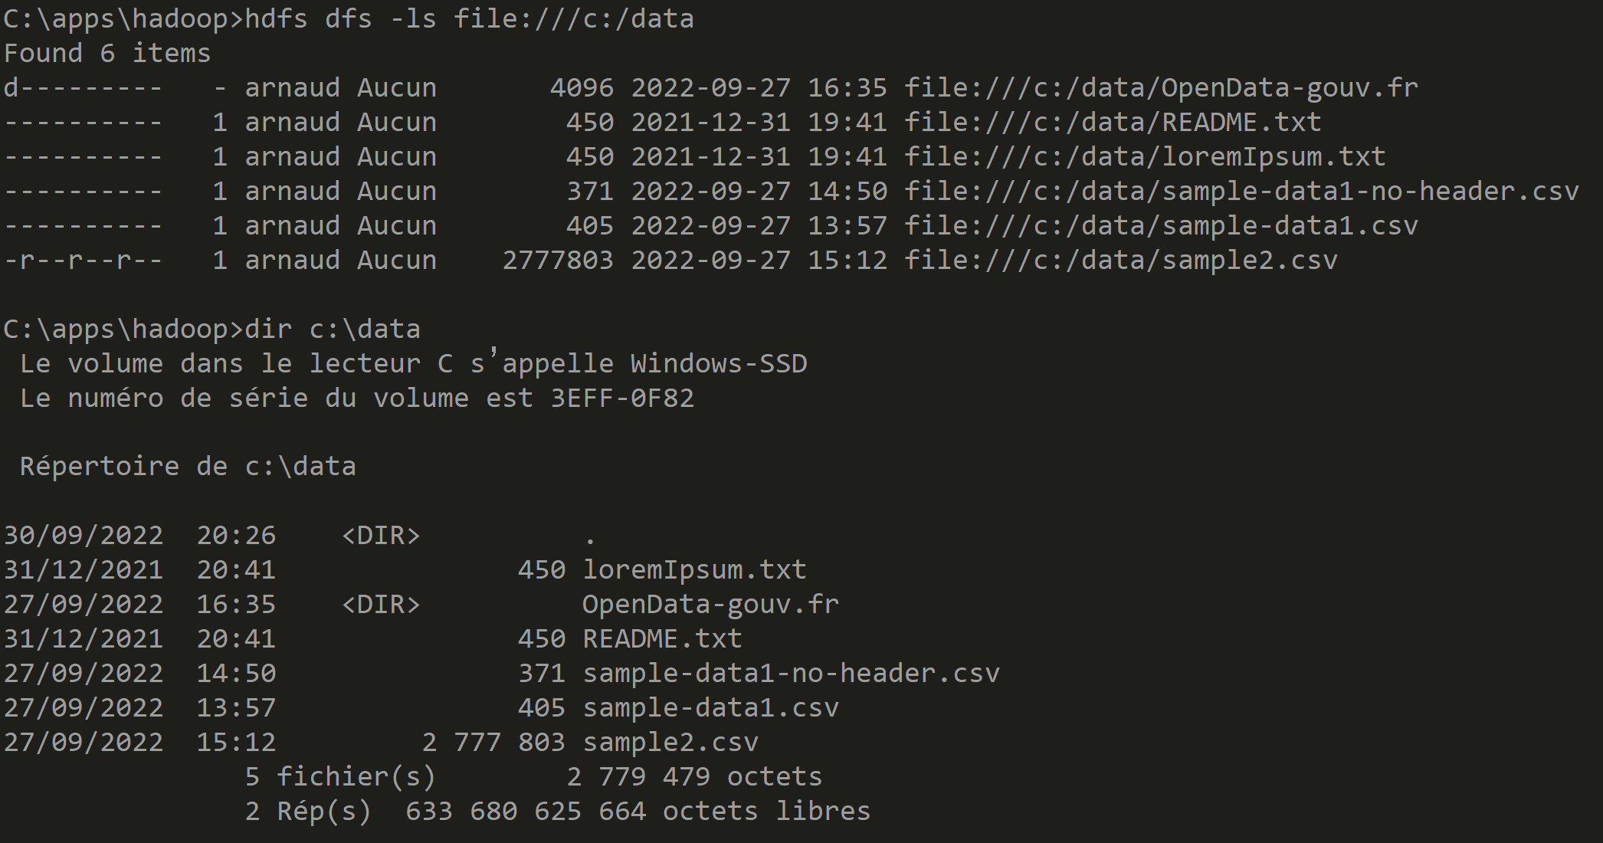
Optionnal when using custom Hadoop Sanity check HADOOP_HOME + PATH
C:> hdfs dfs –ls file:///c:/data

Slide 22
hdfs dfs –ls …
« hdfs dfs » is unix like commands for accessing Hadoop FileSystem
example
hdfs dfs –ls /some-hdfs-dir
# => implicitly converted to «hdfs dfs –ls hdfs://<hdfsServer>/some-hdfs-dir »
hdfs dfs –ls s3:// … for accessing Amazon S3
hdfs dfs –ls abfss:// … for accessing Azure Storage
hdfs dfs –ls file:///c:/local-dir … for accessing local dir ! Notice 3 slashes

Slide 23
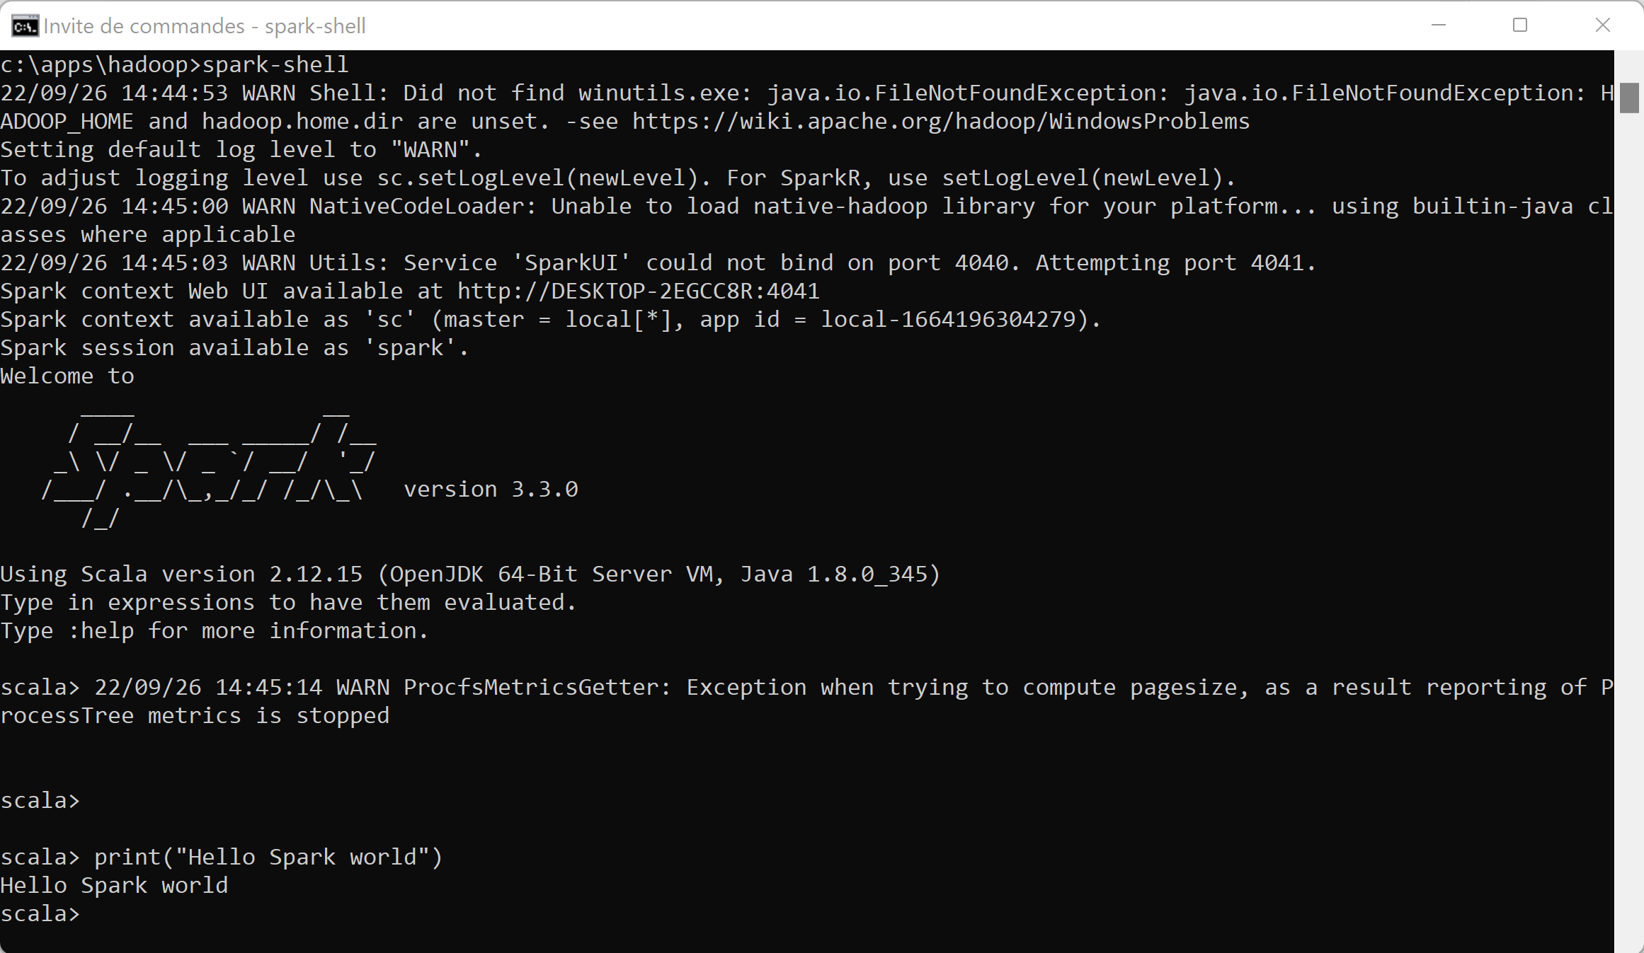
Spark-shell … print(« Hello World »)

Slide 24

Objectives
1/ Install on your (Windows) PC a minimalist local SPARK
2/ Configure it, launch spark-shell
3/ Discover spark-shell scala> REPL
4/ Execute basic spark commands on DataSets, Files

Slide 25
10 mn Pause

Slide 26
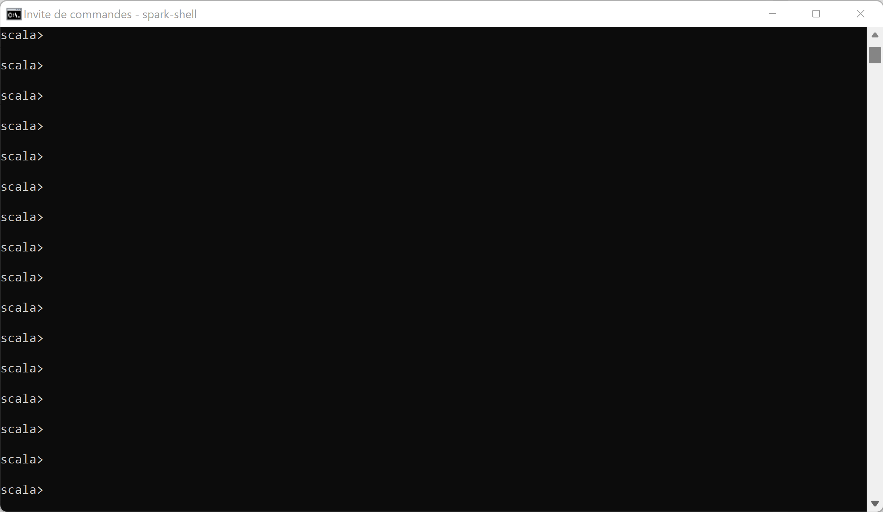
Discover Spark-shell type <enter> <enter> <enter> …

Slide 27
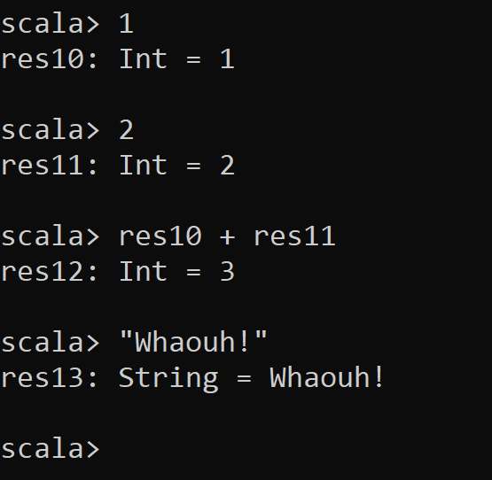
REPL = Read – Eval – Print - Loop
For each line,
Spark evaluate (compile in scala code)
Result is printed, with type information
and assigned to variable « res${i} » where « i » is incremented
Variables can be re-used by name

Slide 28
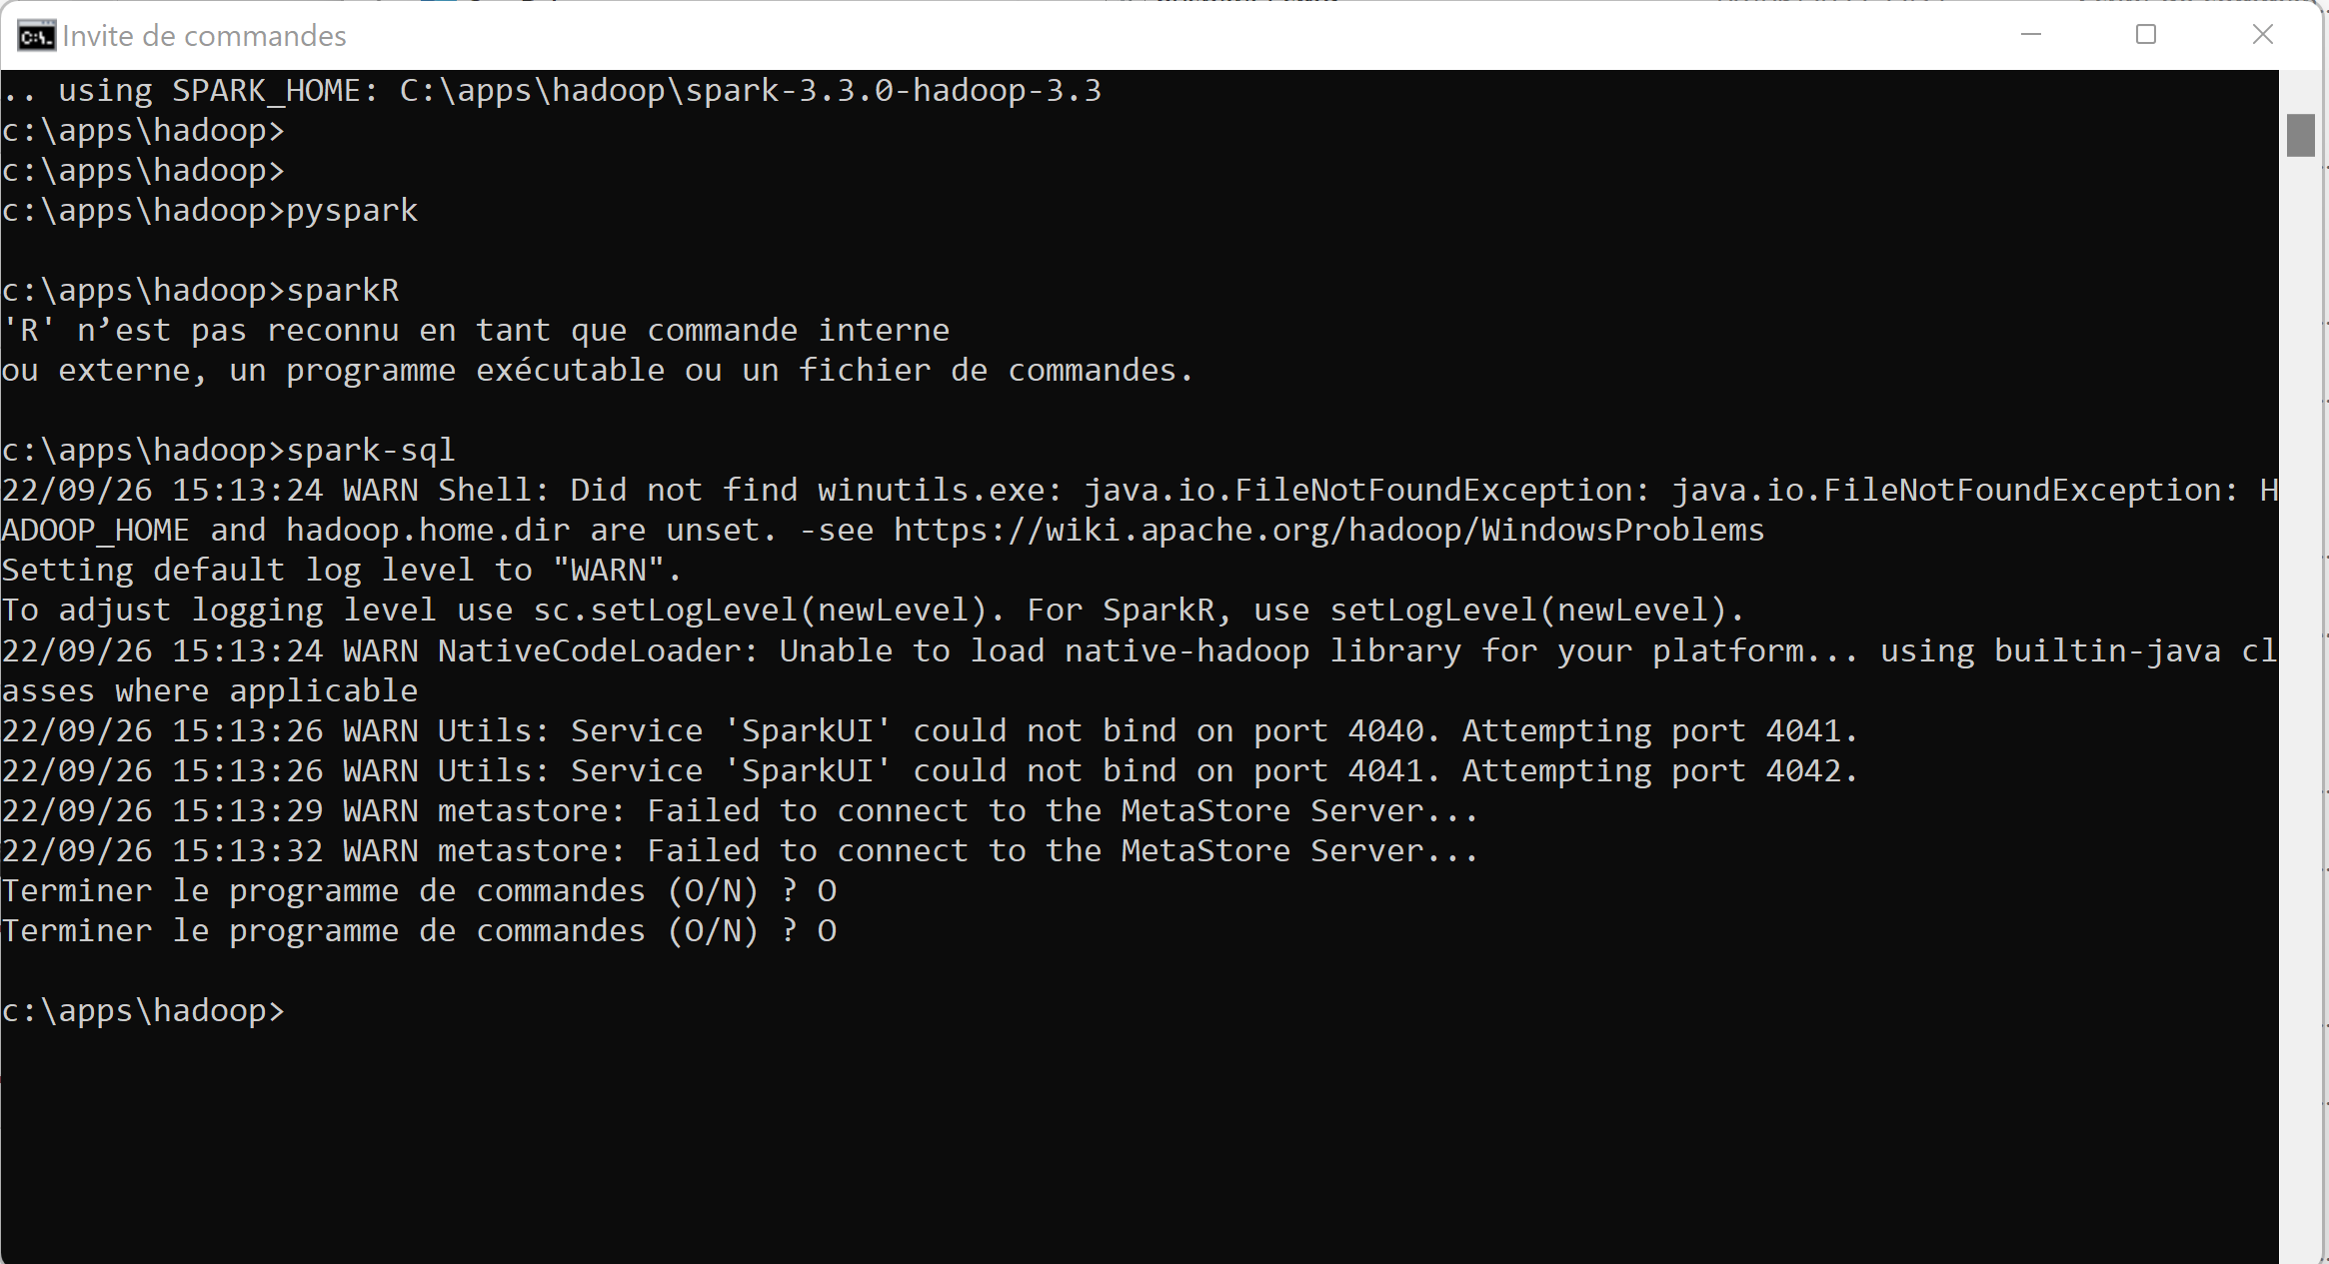
Not only spark-shell… pyspark => need python exe sparkR => need ‘R’ exe spark-sql => need connect to Hive MetaStore Server

Slide 29
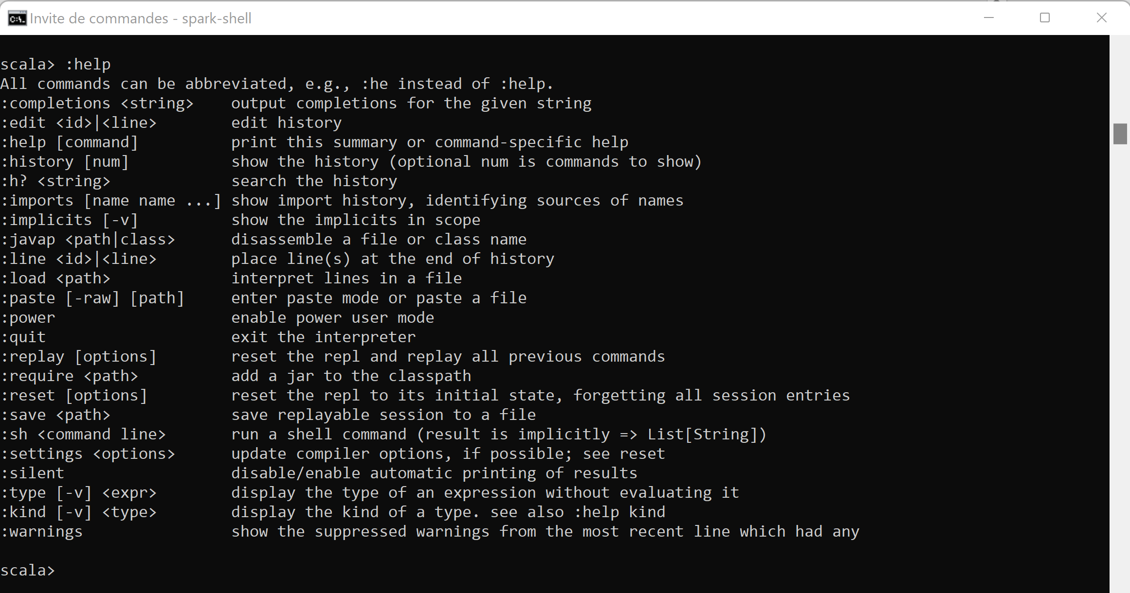
Discover built-ins commands, :help

Slide 30
Discover History
Exercise : a/ Type 5 basic commands: print(« line1 ») <ENTER> print(« line2 ») <ENTER> …. print(« line5 ») <ENTER>
b/ navigate scroll UP and Down to retype command N
c/ replay all commands, using « :replay »
c/ save session in file « my-supper-commands.txt »

Slide 31
Interactive Line Edit Jline ( ~GNU readline)
Remember the following standard shortcuts
CTRL+L : clear screen
CTRL+a / CTRL+e : jump to begin/end of line
CTRL+d : delete char
CTRL+k : kill rest of line, put in buffer
CTRL+y : paste line from buffer
Scroll Up / Down : previous/next line from history

Slide 32
Discover History (stop + relaunch spark-shell)
Exercise : a/ Stop you spark-shell
b/ restart a spark-shell
c/ do you still see your previous commands (Scroll Up)
d/ do you still see your history ?
e/ Find in which file are written your commands ? … search for hidden « .scala_history » file, in your home directory C:\users\<login>\.scala_history

Slide 33
Exercise using « :save », « :load »
a/ save all commands session in file « my-super-commands.txt »
b/ load and re-execute commands from file

Slide 34
Exercise using « :replay », « :reset »
a/ replay all in once your previous commands, using « :replay »
b/ reset commands… see History after

Slide 35
Discover Multi-Line edit support
How to type 1 command containing several lines ??
For example a for loop, with if –then-else
Or more realistic … SQL query on select line: SELECT … FROM … WHERE …
Answer:
Type « :paste » then copy& paste multiple lines… or simply type several lines with <enter> When finished, press « Control + D »

Slide 36
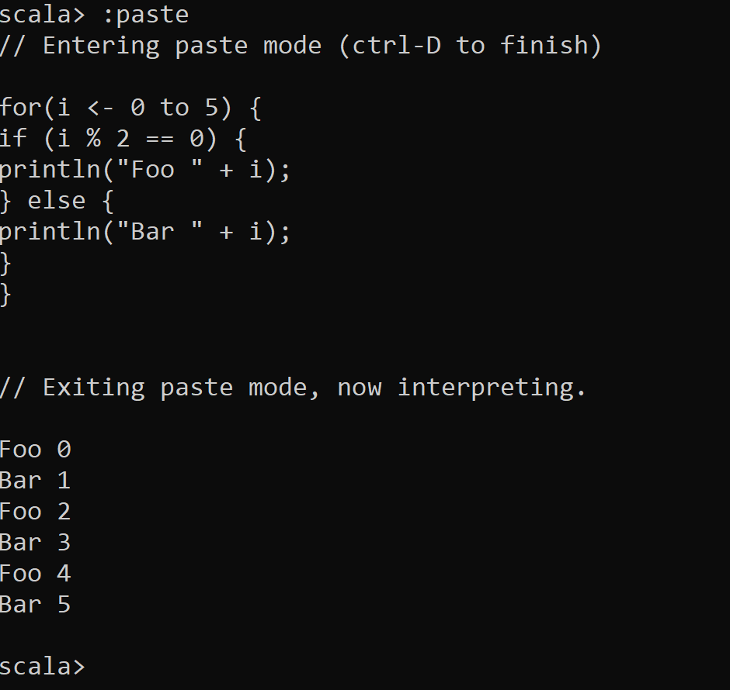
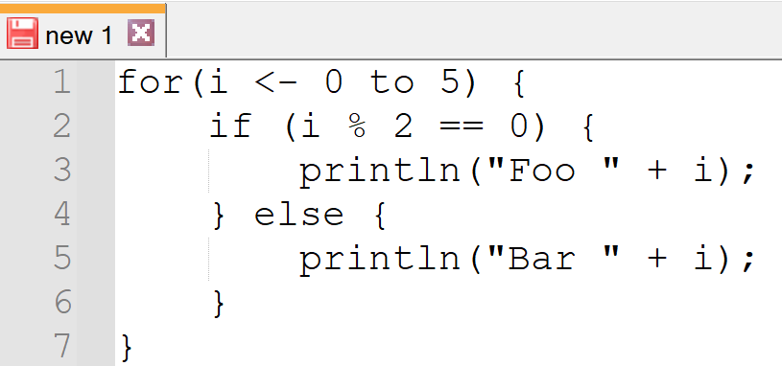
Using :paste … Control+D

Slide 37
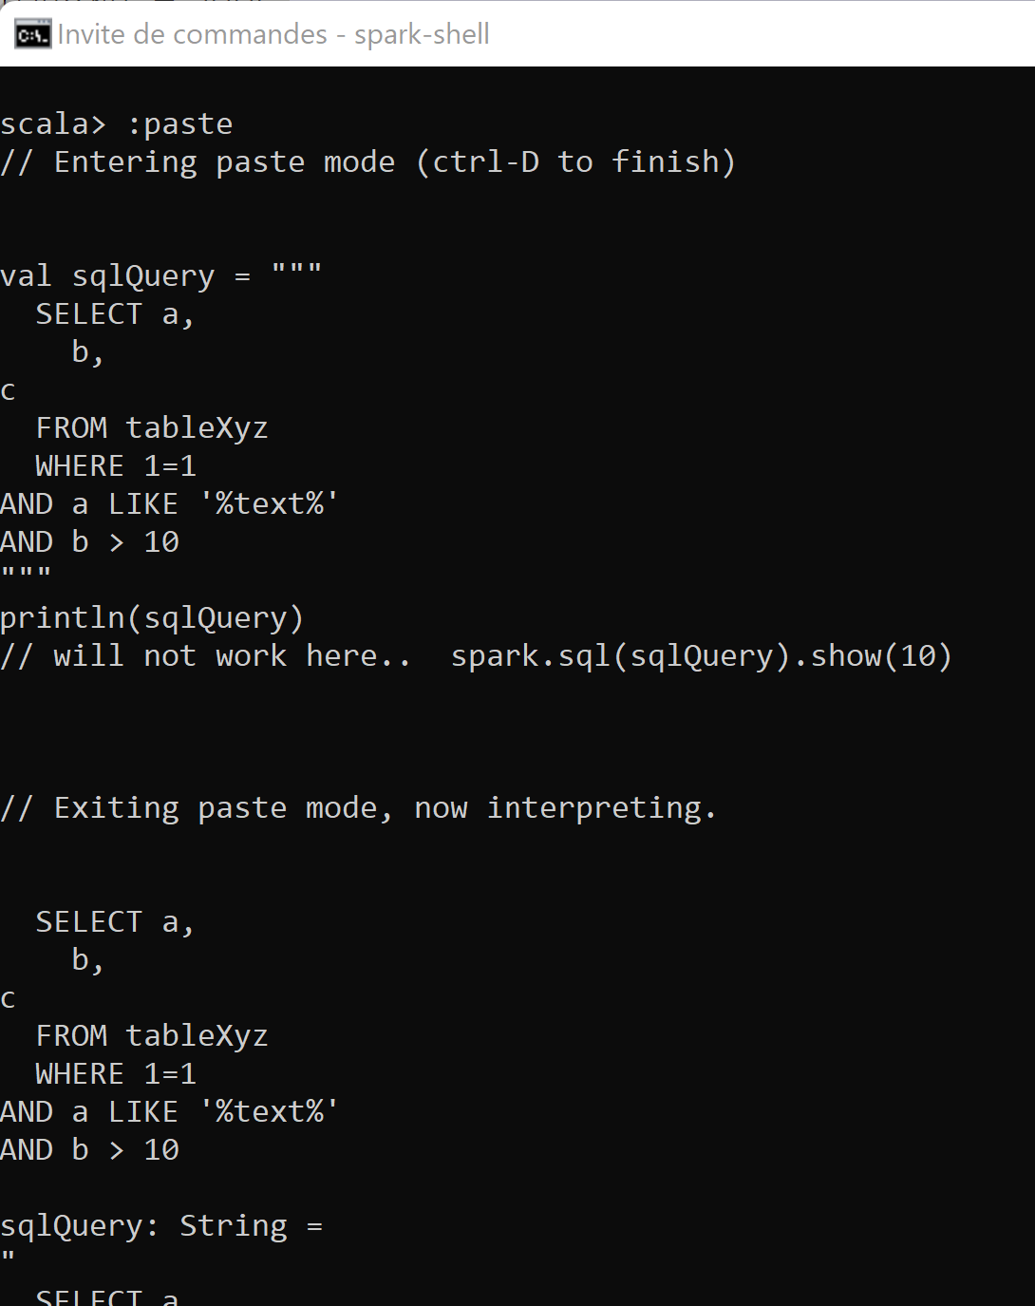
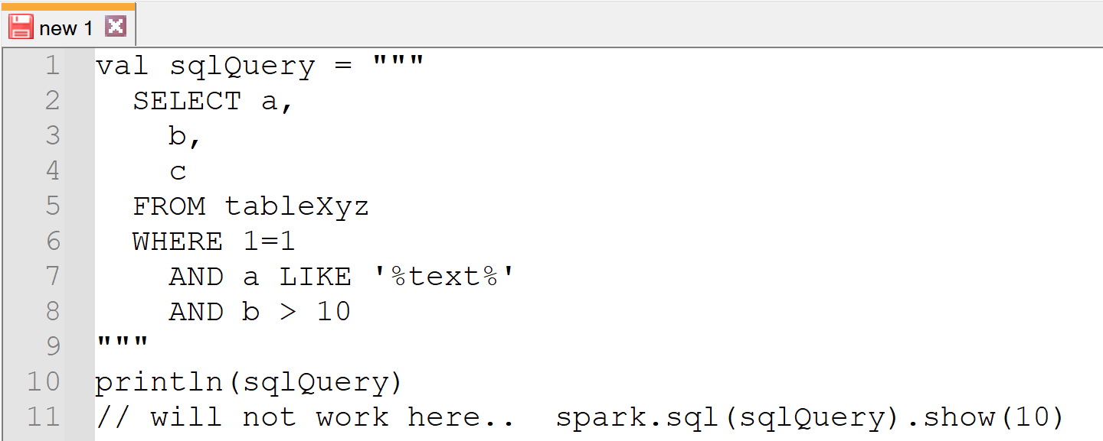
Using Multiple line String (example: SQL) triple quotes

Slide 38
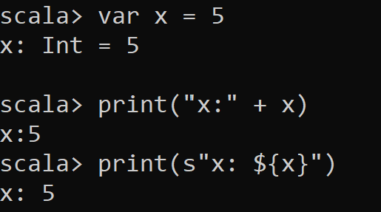
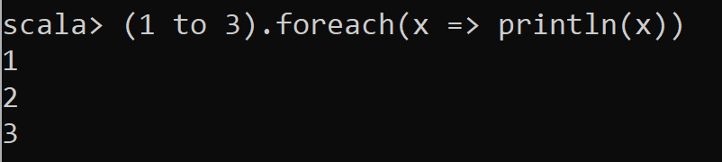
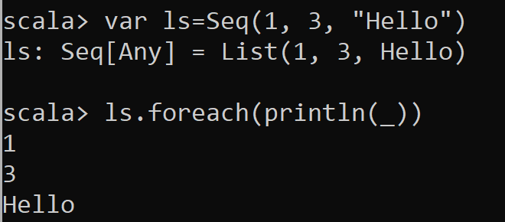
Spark-shell is a « REPL » for Spark in « scala »
Scala basic commands …
More Scala …
More Scala with … Sequence, implicit Lambda, « _ » var

Slide 39
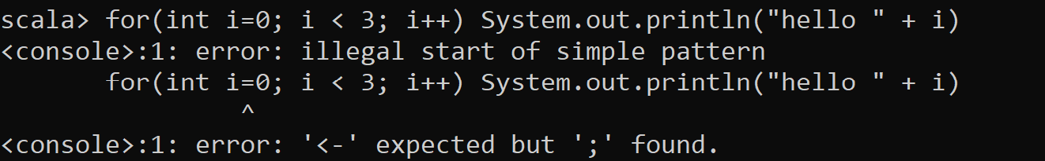
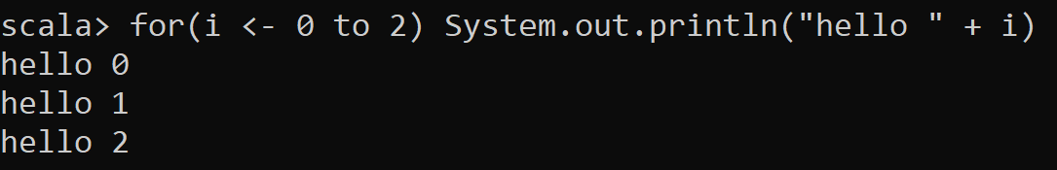
« Scala » .. ~ a super set of « Java » Scala runs on the JVM
… but not exactly

Slide 40
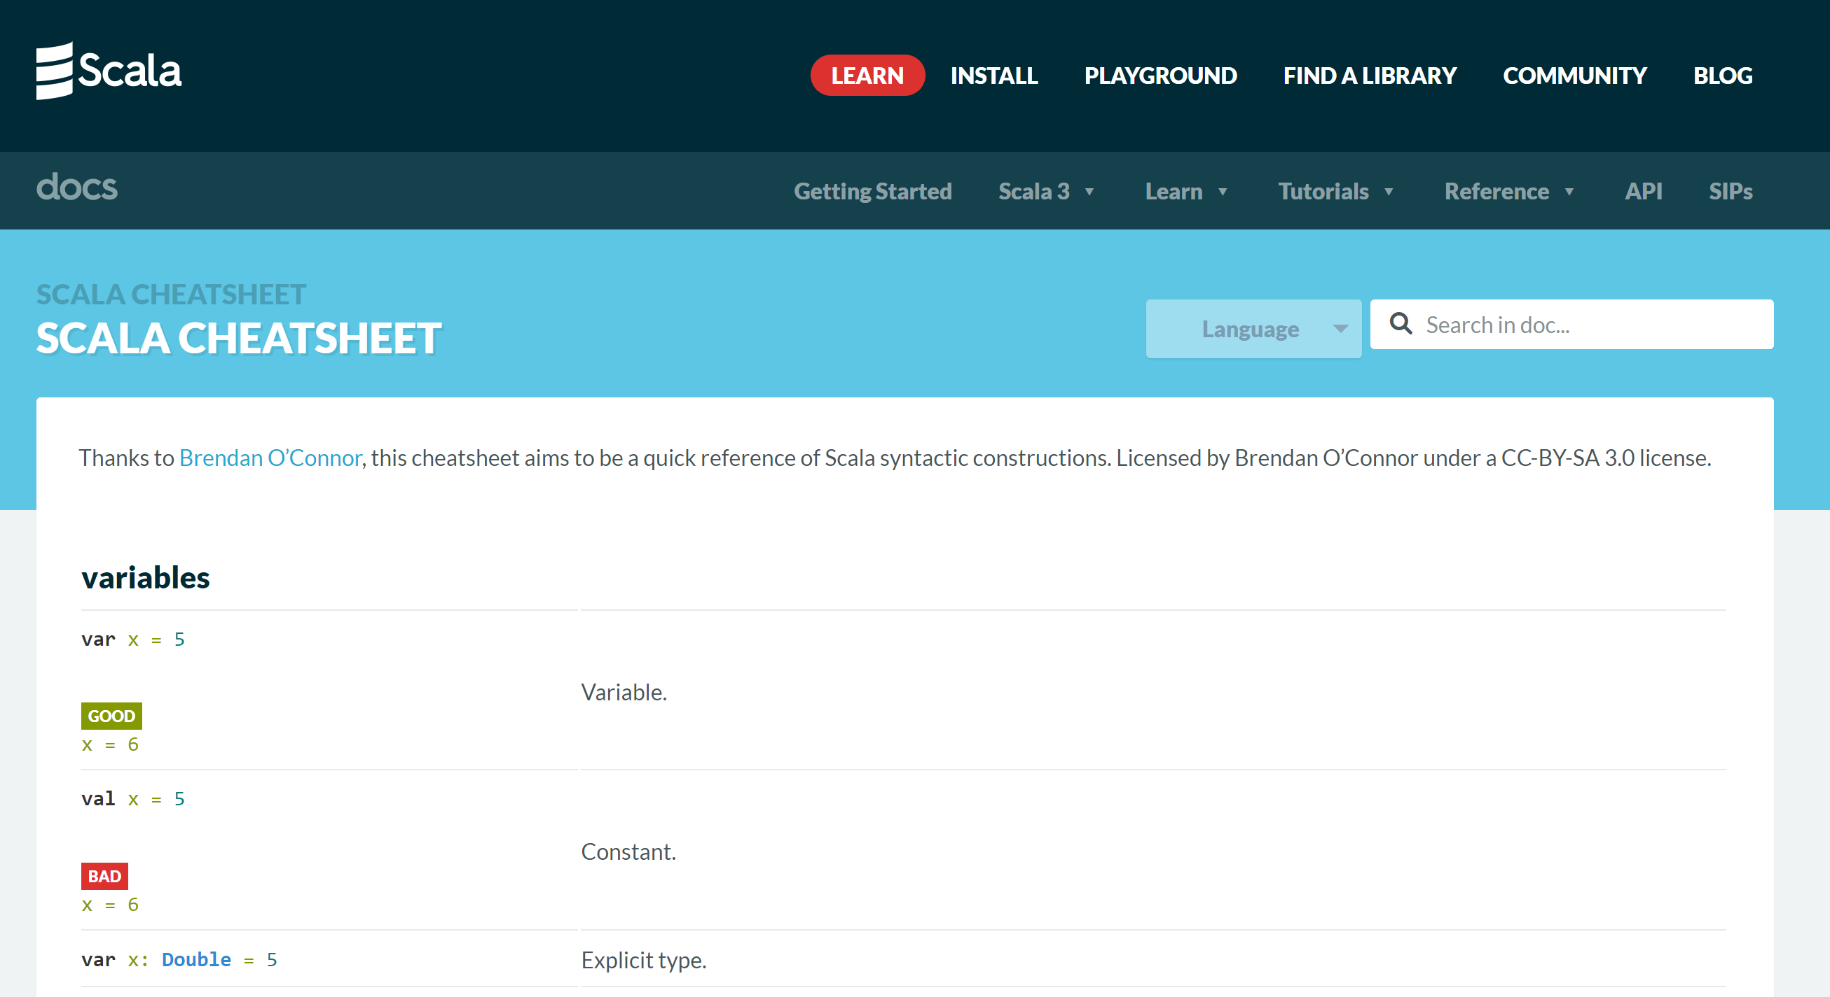
https://docs.scala-lang.org/cheatsheets/
5-10 minutes
Reading

Slide 41
Objectives
1/ Install on your (Windows) PC a minimalist local SPARK
2/ Configure it, launch spark-shell
3/ Discover spark-shell scala> REPL
4/ Execute basic spark commands on DataSets

Slide 42
Introduction to Exercises 1,2,3,4,5 … The goal is to create a spark DataSet..
Expected DataSet = List of 100_000 rows each row containing a Tuple of ( int : i, boolean : true if i is even, string: « hello ${i} » )

Slide 43
Exercise 1 : create a List of 3 Tuples
var ls = ???
With expected content: (1, false, "hello 1") (2, true, "hello 2") (3, false, "Hello 3")

Slide 44
Hint Exercise 1
In scala,
« (a, b, c) » creates a Tuple with 3 fields _1,_2,_3 with _1=a, _2=b, _3=c
« Seq(a, b, c) » create a Sequence (synonym: List) of 3 elements: a, b, c

Slide 45
Answer Exercise 1

Slide 46
Exercise 2: same, but create an empty List, and successively add 3 rows … the (non idiomatic) Java way

Slide 47
Hint exercise 2
List are immutable !
You can create a new List, as the concatenation of 1 element and an existing list
List has « :: » operator, not Seq !
var ls = List[Object]()
var ls2 = a :: ls
« a » and « ls » must have same generic type!
Use « List[Type] » instead of « List() »
Type is … (Int, Boolean, String)

Slide 48
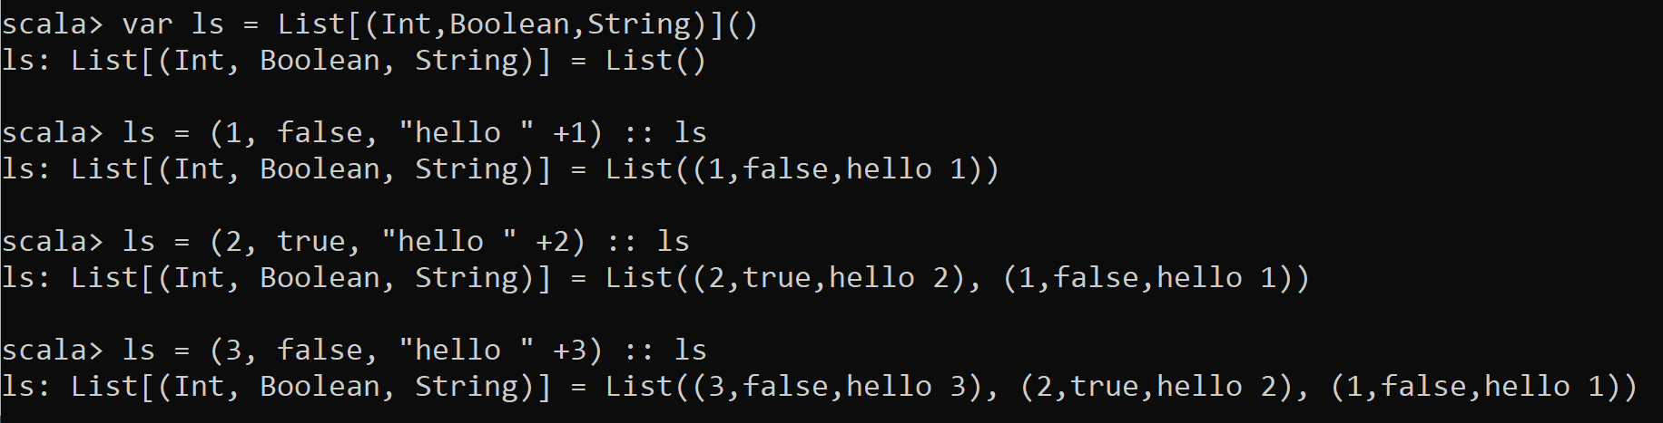
Answer Exercise 2 … the (non-idiomatic) Java Way..

Slide 49
Exercise 3 .. Same using « functional » code style: transform the sequence (1, 2 … 10000) into Tuples using « map » lambda function

Slide 50
Hint Exercise 3
« .map( f ) » is a method of List,
to map all elements from source type X to target type Y
taking a function « f » as parameter : « f(X) -> Y » … f can be written as a lambda: « x => { ..return y;} »
Source : List[X]
transformationFunction : X -> Y
target : List[Y]

Slide 51
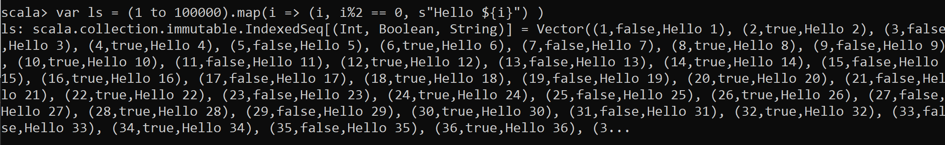
Answer Exercise 3

Slide 52
Exercise 4: display result from previous exercise 4a / display length of result 4b/ display row 0 tuple 4c/ display row 0, individual fields from tuple

Slide 53
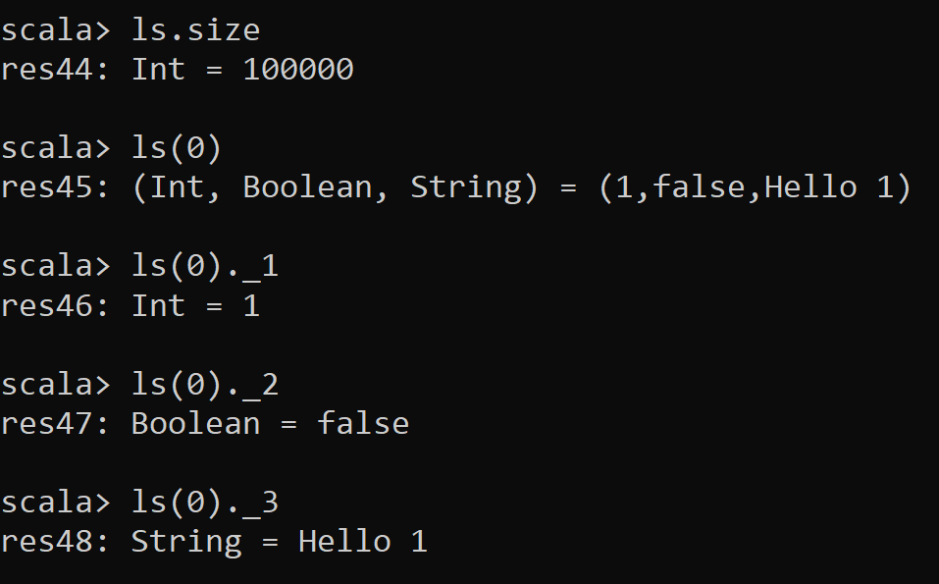
Answer Exercise 4

Slide 54
Exercise 5: create a spark DataSet of 100_000 rows each row containing a Tuple of int : i boolean : true if i is even string: « hello ${i} »

Slide 55
Hint Exercise 5
Just use
spark.createDataset() method
« spark » is a built-in variable
You can type « spark.create » and press TAB TAB to autocomplete

Slide 56
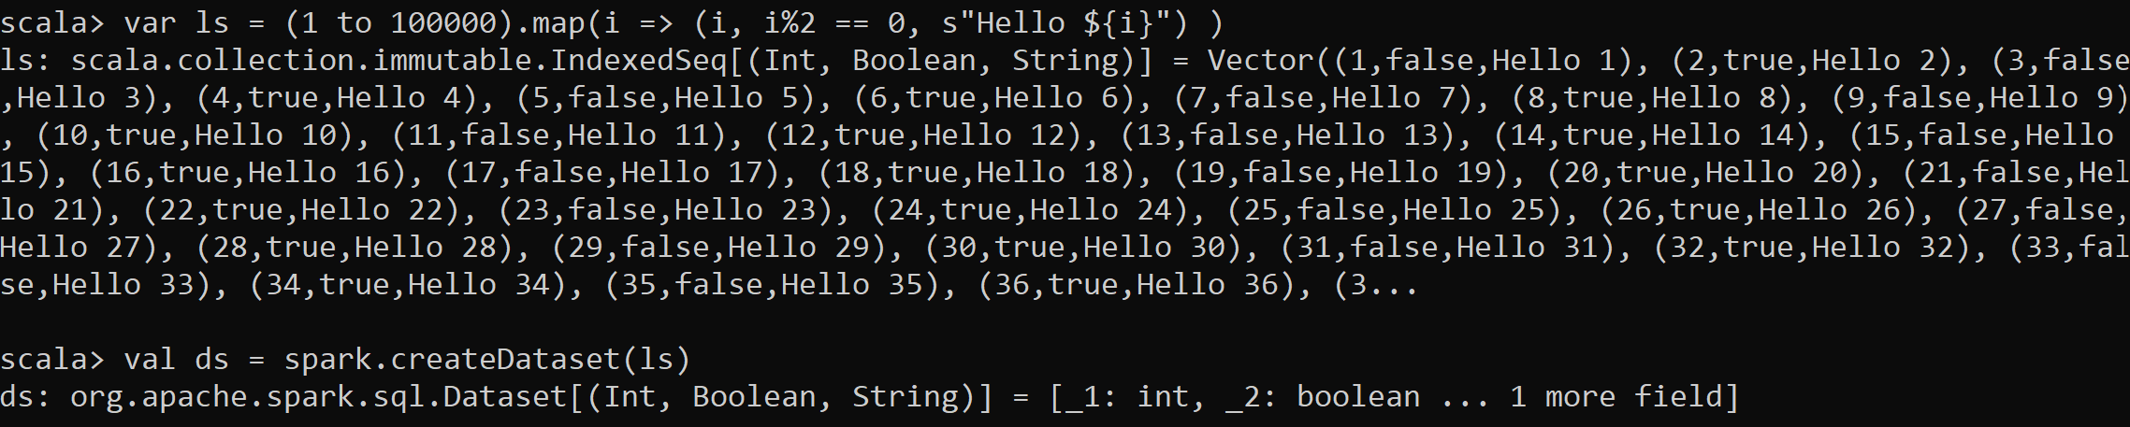
Answer Exercise 5
Equivalent 1-liner solution :

Slide 57
Exercise 6: Display result DataSet of ex. 5
6a / display number of rows
6b/ show first rows (default: 20)
6c/ show only first 2 rows
6d/ show individual columns of row0

Slide 58
Hint Exercise 6
Like on Seq or List … Dataset accept many methods,
like « .show() », « .count() », « .take() » etc.

Slide 59
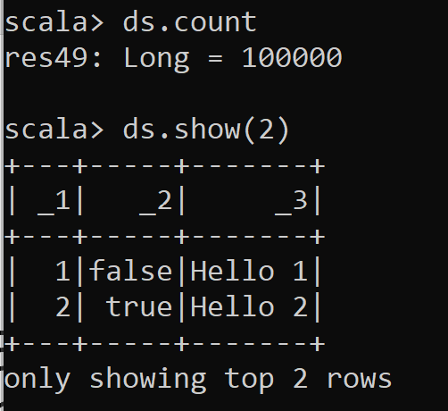
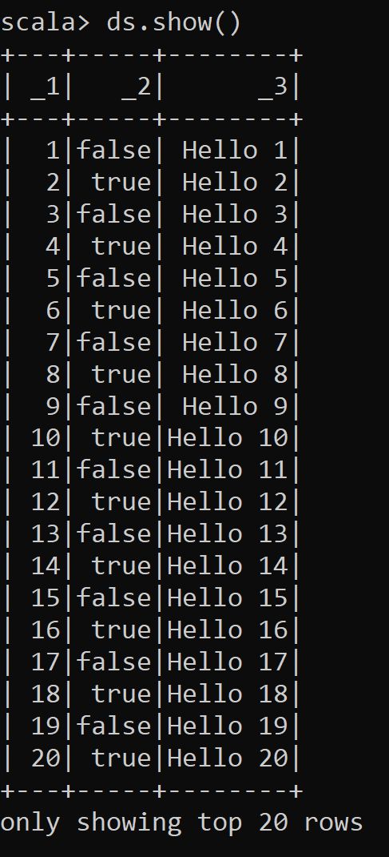
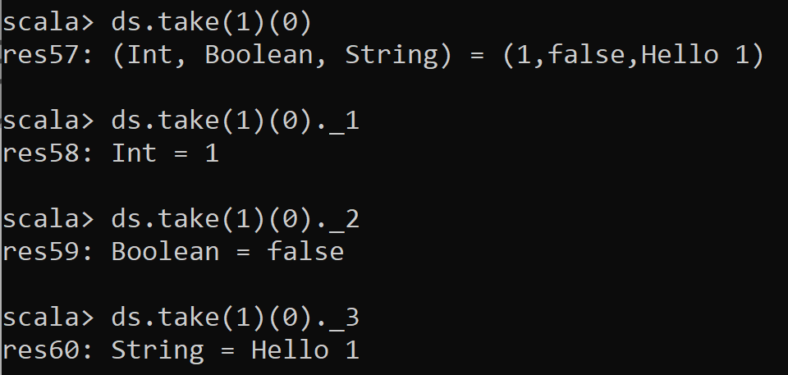
Answer Exercise 6
By default… « .show() » => same as « .show(20) » .. => same as « .show(20, true) »

Slide 60
Exercise 7: Rename columns
Rename columns _1,_2,_3 to « id », « even », « text »

Slide 61
Hint Exercise 7
Use dataset.withColumnRenamed()
… remember Dataset are immutable !
Most Dataset method returns a new Dataset
so cascade calls (or assign intermediate results)
repeat the operation 3 times

Slide 62
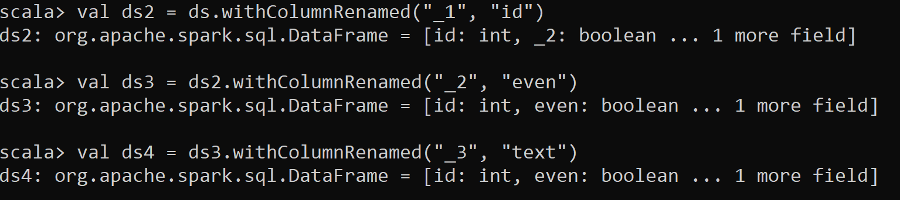
Answer Exercise 7
Ds … is unmodified … still has _1, _2, _3 columns
More idiomatic: cascade methods

Slide 63
Exercise 8
Filter rows where « id » is « >= 100 »
Using « filter(Column) » operators
To create an expression on column « id » of dataset « ds »,
You can use « ds(« id ») » OR implicit equivalent $«id »

Slide 64
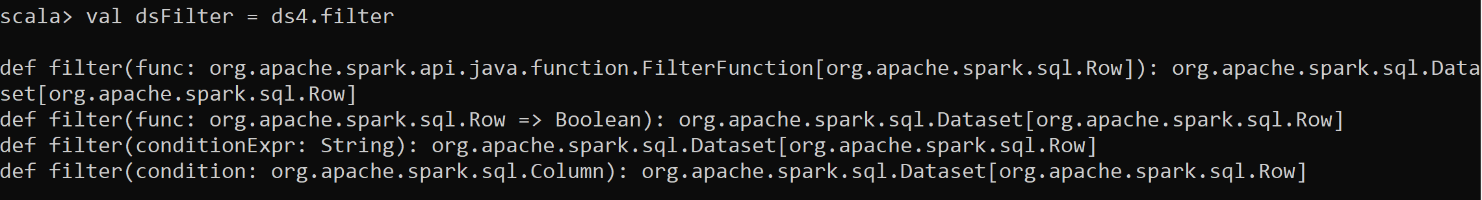
Hint Exercise 8
Type « .filter» and pres TAB TAB to autocomplete
You can see there are 3 possible overloads for method
use « .filter( ds(« columnName») operator… ) »
It is more complex than using SQL conditionExpr… cf exercise 9
But It is simpler than exercise 10 … using lambda predicateFunc : row -> boolean

Slide 65
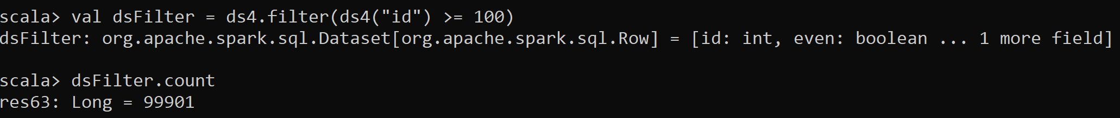
Answer Exercise 8

Slide 66
Exercise 8
Filter rows where
« id » is « >= 100 » AND
«text » contains substring « 12 »

Slide 67
Hint Exercise 8
Spark as overriden most of the natural operators on class « Column »
Including >=, &&, ||, !, contains, …
You can manipulate columns objects almost as values in scala

Slide 68
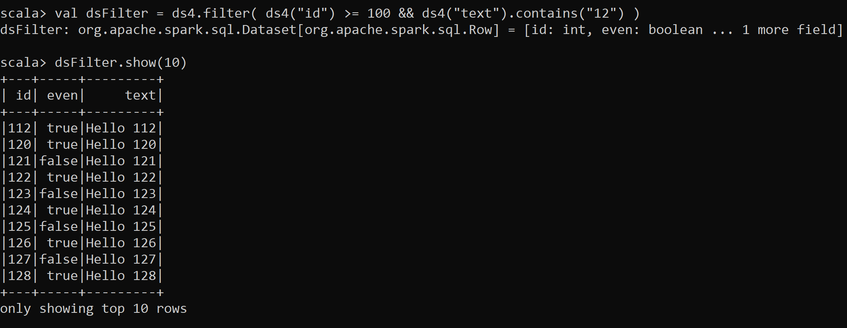
Answer Exercise 8

Slide 69
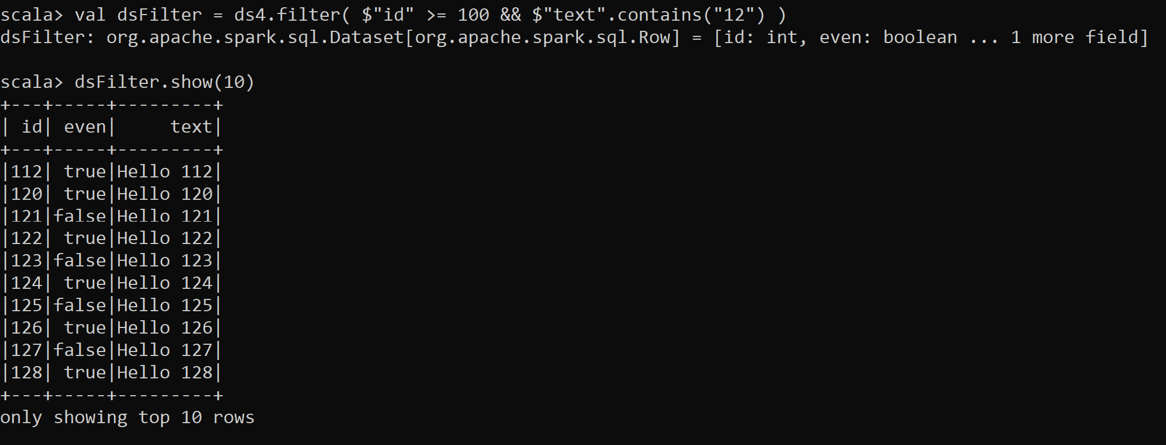
Alternative Answer Exercise 8

Slide 70
Exercise 9
Redo exercise 7,8 using filter by SQL text expression

Slide 71
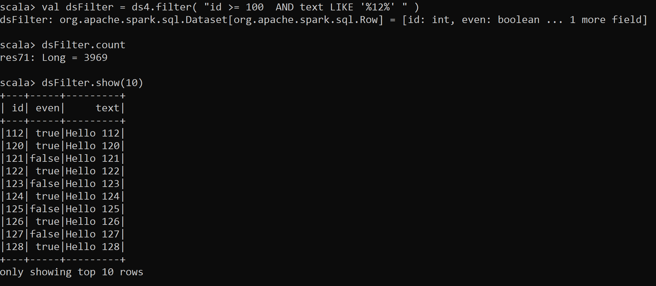
Answer Exercise 9

Slide 72
Exercise 10
Same as exercise 7,8,9… but using « .filter(row => …) »
i.e. Filter with lambda function on row
Use getAs[Type](« columnName ») to extract the value of a column, and cast

Slide 73
Hint Exercise 10
Method signature is
.filter( (or.apache.spark.sql.Row row) => boolean)
You need to extract column value for object « Row », and interpret as Int or String
for column « id » as Int … use « row.getAs[Int]("id") »
For column « text » as String … use « row.getAs[String](« text") »

Slide 74
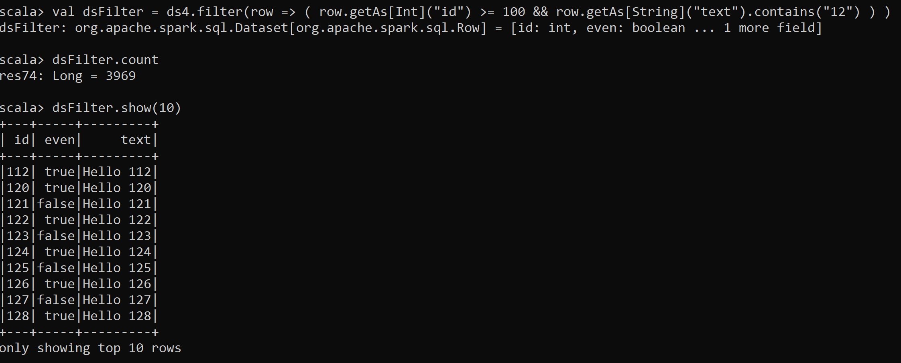
Answer Exercise 10

Slide 75
Exercise 11 : same as exercise 1 (on Tuple), but using your own custom « case-class »
Declare a scala case-class (also named Bean, POJO or Record in java)
To replace the Tuple « (Int,boolean,String) » of exercise 1
Should be equivalent to java class:
public class CustomBean {
public int id;
public boolean even;
public String text; public CustomBean(int id, boolean even, String text) {
this.id = id; this.even = even; this.text = text;
}
}

Slide 76
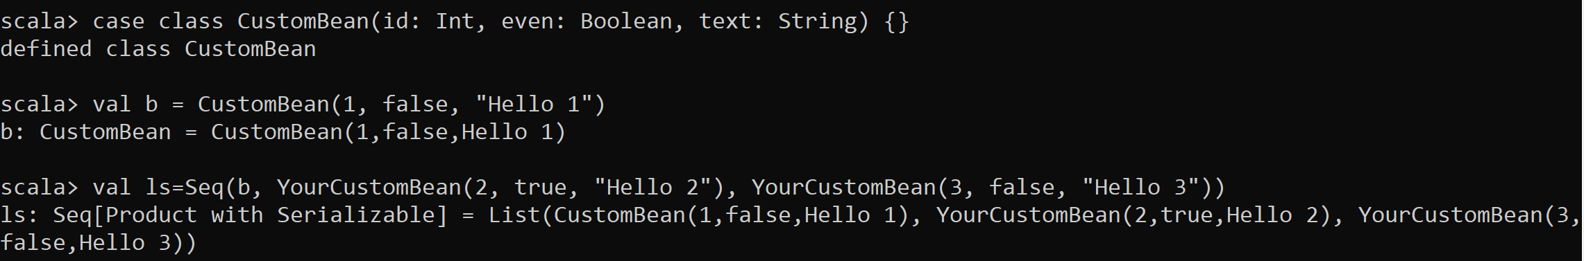
Answer Exercise 11

Slide 77
Exercise 12 : Same as Exercise 5,6,7,8,9 .. Using CaseClass
https://spark.apache.org/docs/latest/sql-getting-started.html#creating-datasets
a/ create a List of 100 000 CustomBean objects, using map + lambda function
b/ create a Dataset[CustomBean] with 100 000 rows
c/ display results : show 10 rows, show row 0, show individual fields of row 0
d/ filter Dataset with « id > 100 and text contains ’12’ »

Slide 78
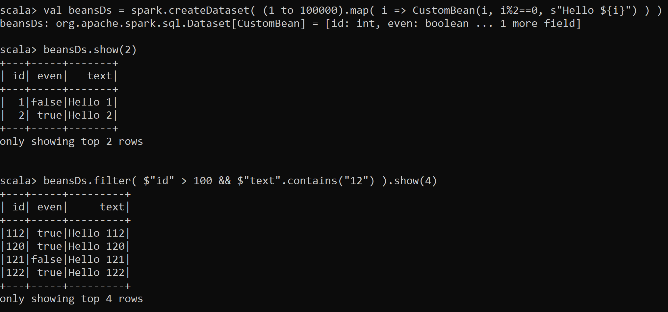
Answer Exercise 12

Slide 79
Exercise 13 : convert to DataFrame (Dataframe = Dataset<Row>)
a/ What was the type of « ds » (from exercise 5) ?
b/ What is the type of « dsFilter » (from exercise 8) ?
c/ What is the type of « beanDs » (from exercise 12) ?
d/ Convert a Dataset of tuple « ds » (from exercise 5) to a spark DataFrame
e/ Convert a Dataset of custom Bean « beanDs » (from exercise 12) to a spark DataFrame

Slide 80
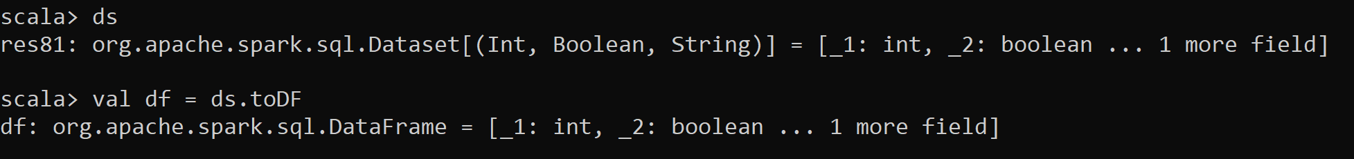

Answer Exercise 13
Type, then conversion:
After a filter() operation, Spark has already enterred the magic DataFrame world !
Converting CustomBean->DataFrame… same as Tuple -> DataFrame

Slide 81
Exercise 14 : Question
Do you understand the in-memory difference between ? a/ in memory scala collection of Tuple: Set( Tuple ( …) ) b/ Dataset on scala Tuple: Dataset[ ( ..Tuple ) ]
c/ Dataset on custom class Dataset[ YourCustomBean ]
c/ DataFrame …. Dataset[Row] … means YourCustomBean is the preferred spark one: « Row » What do you think is the most efficient for developping type-safe code, and internally for Spark ?

Slide 82
Answer Exercise 14
Scala collection are only on the Spark driver side
… you may not be able to instanciate 500 Giga otects of these
Dataset (and DataFrame) are distributed over spark executors
To send data over the network, they are serialized then un-serialized.
So it is still real « Tuple » or « CustomBean » object pointers, but on spark executors.
Dataset[Row] is special … Spark internally is able to handle native memory / swap storage.

Slide 83
Exercise 15: question
When do you use { ._1, ._2 } ?
When do you use { .id, .text } ?
When do you use { .getAs[Int](« id »), .getAs[Int](« text ») } ?

Slide 84
Answer Exercise 15
On scala Tuple => you use _1, _2, … field names
On your custom bean => you use your class fieldName (or getter) Example: case class YourCustomBean(id: Int, text: String, foo: String) {}
val bean = YourCustomBean(123, « text », « foo »);
bean.foo
In SQL expression, you use the column name, example « _1 », « id », « text »
On spark.sql.Row => you use org.apache.spark.sql.Row methods !! Example: row.getAs[Int](« foo »)

Slide 85
Exercise 16 : MindMap
Draw a MindMap to summarize
what you did and learn from this TD session
Your MindMap should
start with word « spark-shell » in the middle
Then draw star edges to other word chapters and sub-chapters

Slide 86
Hint Exercise 16
DataSet
Installation
Spark-Shell
Interactive
Functionnal
Code Style
Scala>
Repl

Slide 87
Objectives
1/ Install on your (Windows) PC a minimalist local SPARK
2/ Configure it, launch spark-shell
3/ Discover spark-shell scala> REPL
4/ Execute basic spark commands on DataSets

Slide 88
Take-Away What You learned ?

Slide 89
Mind Map
Set JAVA_HOME
Set SPARK_HOME set PATH
JVM
WinUtils
Transform, filter
Setenv.bat
DataFrame=Dataset[Row]
Pre-Requisite
Val ds = spark.createDataset()
Spark.tar.gz embedded Hadoop
ds.show(10, true)
DataSet
Installation
User-defined
Hadoop.tar.gz
Immutable
Spark-Shell
Interactive
Windows error?
avoid
for () {} loop
Functionnal
Code Style
History
Seq
.map
lambda
Up / Down
Scala>
Repl
:help
TAB TAB autocompletion
Line compiled to scala
Eval on <enter>
val i =
var i =
Seq()
Tuple
On JVM
~Java
Numbered result « res0,res1,.. »

Slide 90
Questions ?

Slide 91
Next Steps
More CMs
More TDs
Spark concepts:
File Input / Output
PARQUET columnar files
SQL
Spark Clustering
DAG, Distribution, Optimizations
Java binding, UDF, map
Spark Streaming
…

